Slide 1
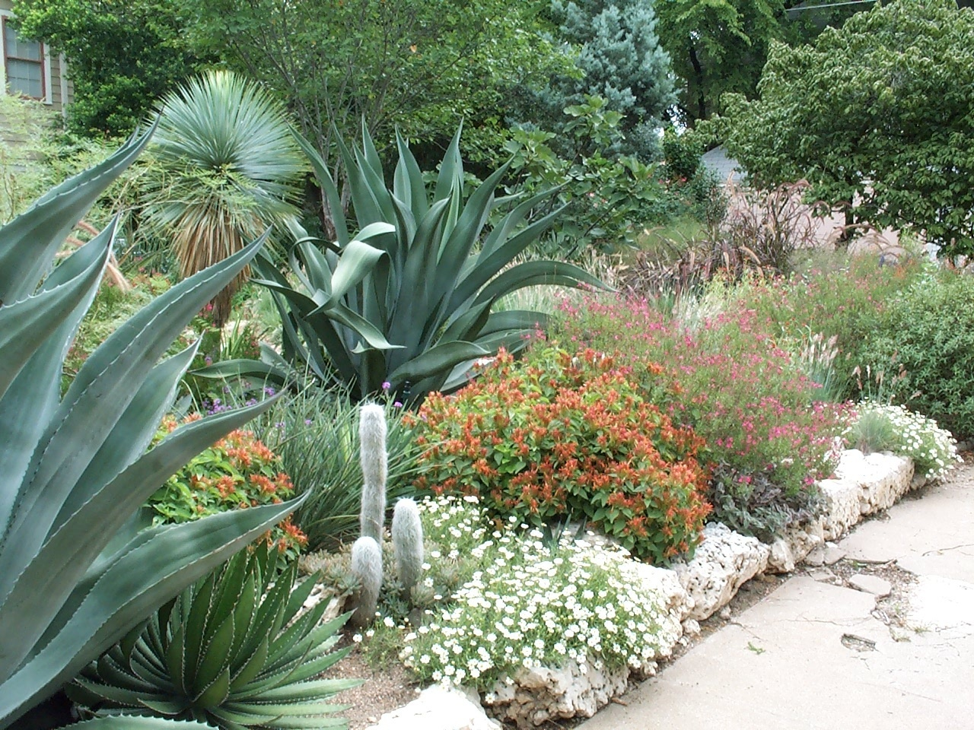
Water-Wise Landscaping
Barbara Storz, M. S.
Extension Horticulturist – Hidalgo County
Texas AgriLIFE Extension Service

Slide 2
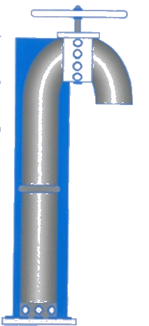





Millions of
Acre-Feet
Texas Water Use by Category
9.0
7.5
6.0
4.5
3.0
1.0
0
Steam-Electric
Generation
Livestock
Mining
Irrigation
Municipal
Manufacturing
65 %
20 %
9 %
3 %
2 %
1 %

Slide 3
Water Use Priorities
Personal Use
Fire Safety
Food production
Power Generation
Manufacturing / Industrial
Lawn & Landscape

Slide 4
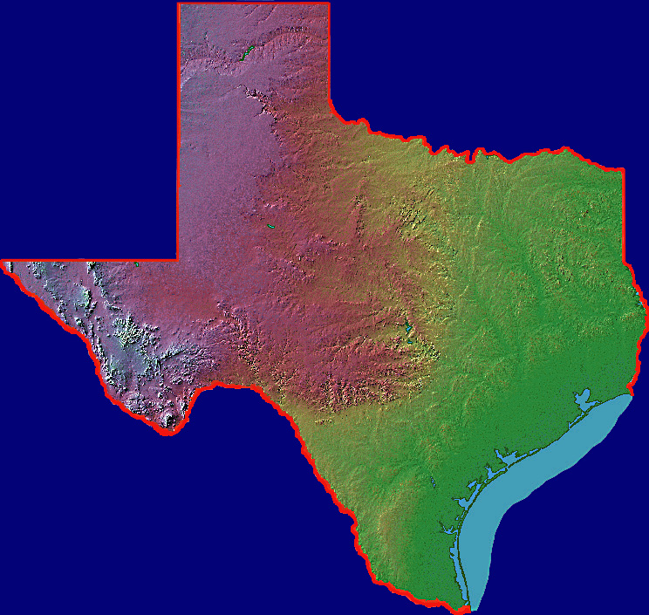
Annual Rainfall
10”
20”
30”
40”
50”
5”

Slide 5
It has been projected that by the year 2035,
Texas will have only about
85% of the water required to meet the needs of our population.

Slide 6
Where Will Our Water Come From?

Slide 7
An estimated
782 billion gallons of water is used each year in Texas for home lawn irrigation.
Half of this is wasted.

Slide 8
Water-Wise Landscaping:
“Landscaping with
2020 Vision”

Slide 9

7 Xeriscape Principles
Planning and design
Soil analysis
Appropriate plant selections
Practical turf areas
Efficient irrigation
Use of mulches
Appropriate maintenance

Slide 10
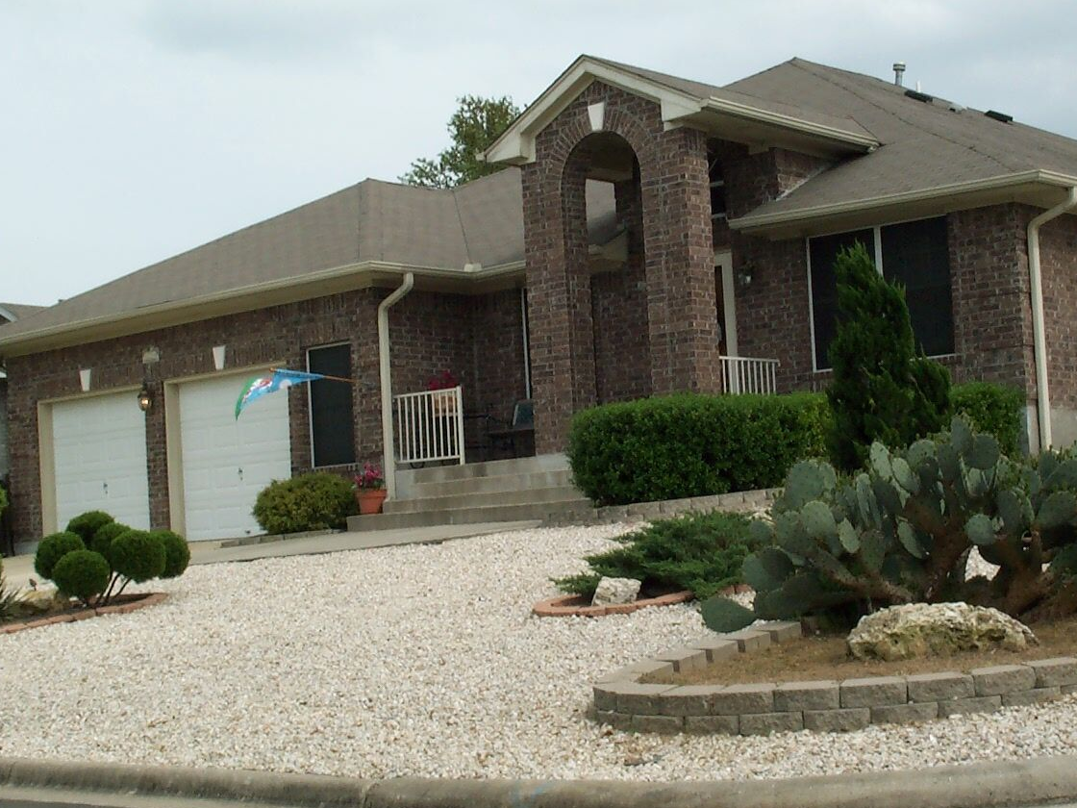
...not a “Zeroscape”...

Slide 11
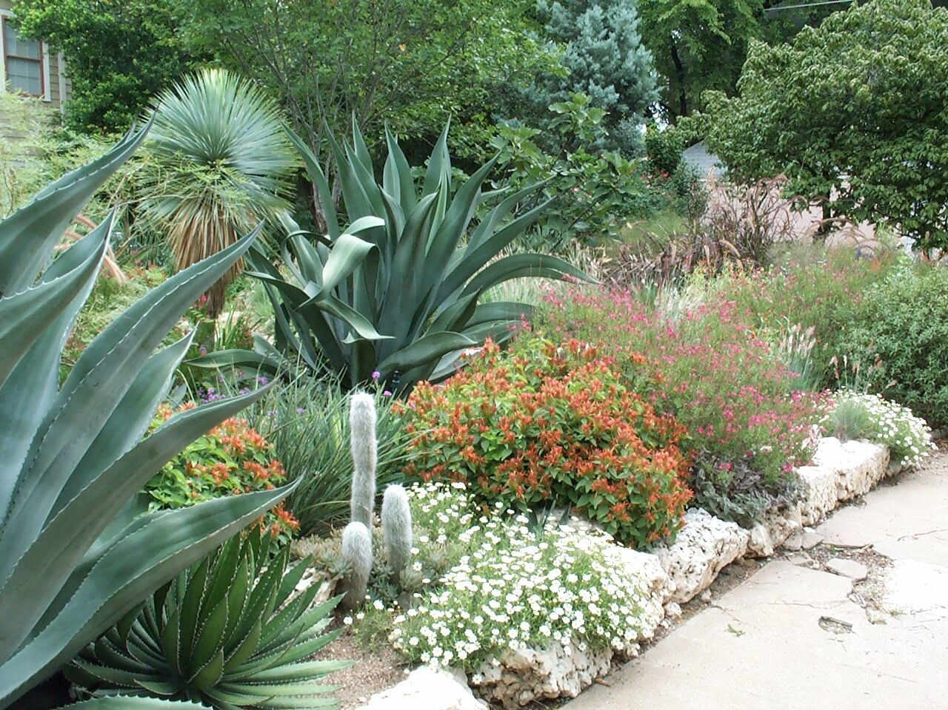
…but a beautiful, water-efficient landscape...

Slide 12
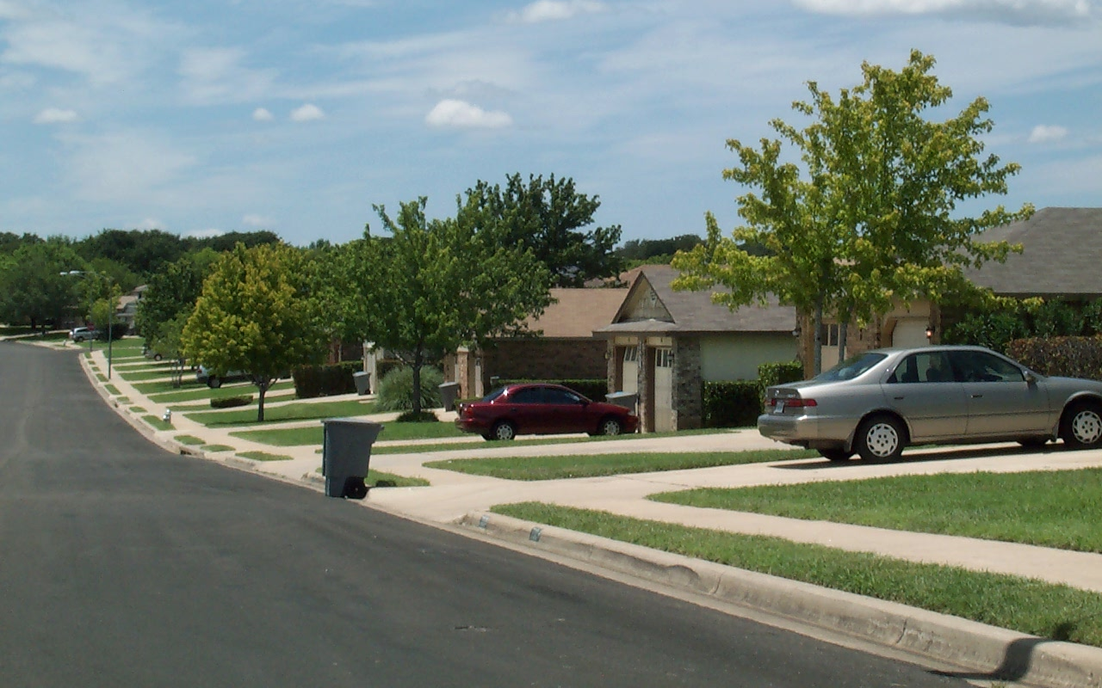
“Cookie Cutter” Landscapes

Slide 13
Narrow strips of turf are impossible to irrigate without wasting water!

Slide 14
Water-Wise…
Design

Slide 15
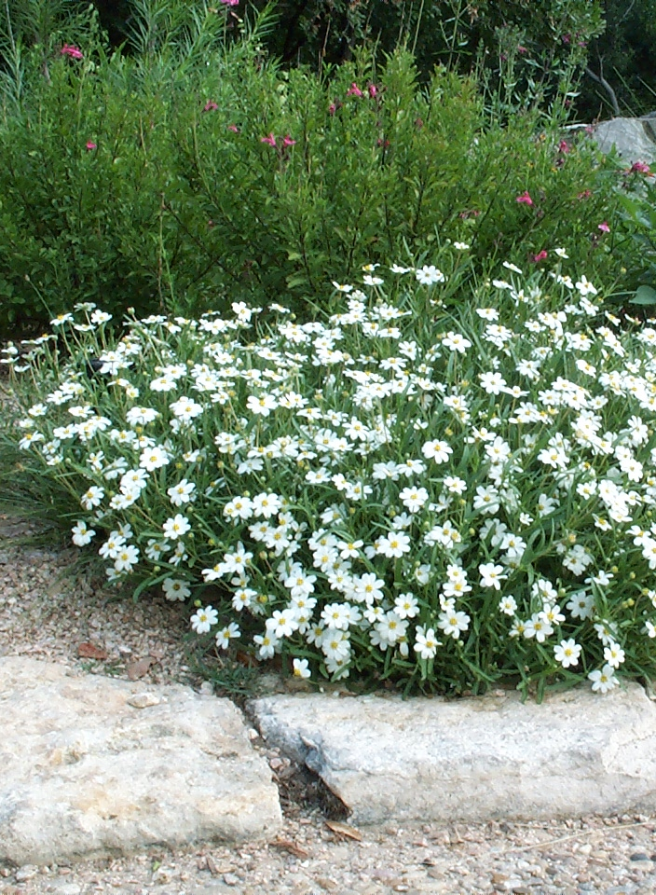
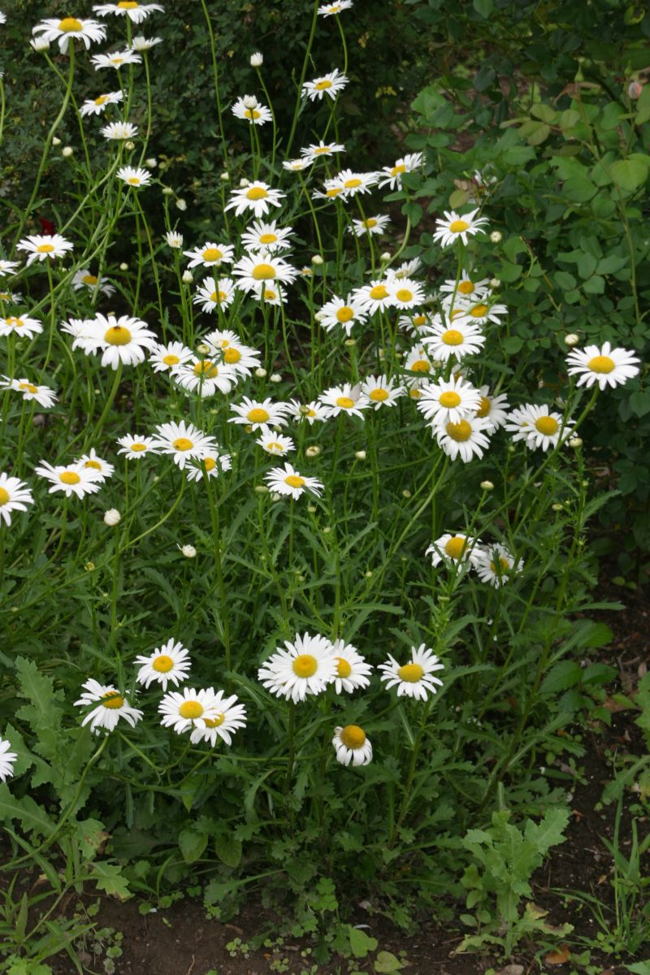
Select Water Thrifty Plants

Slide 16
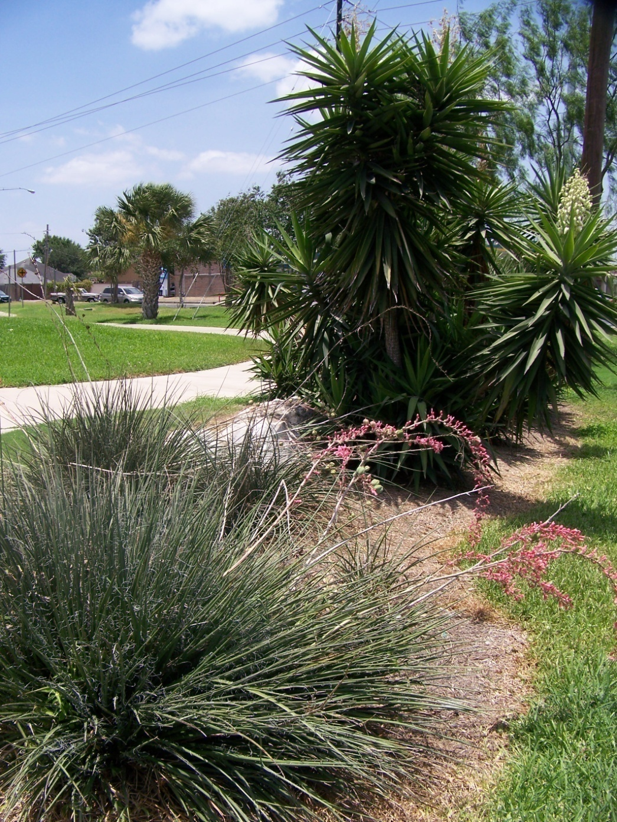
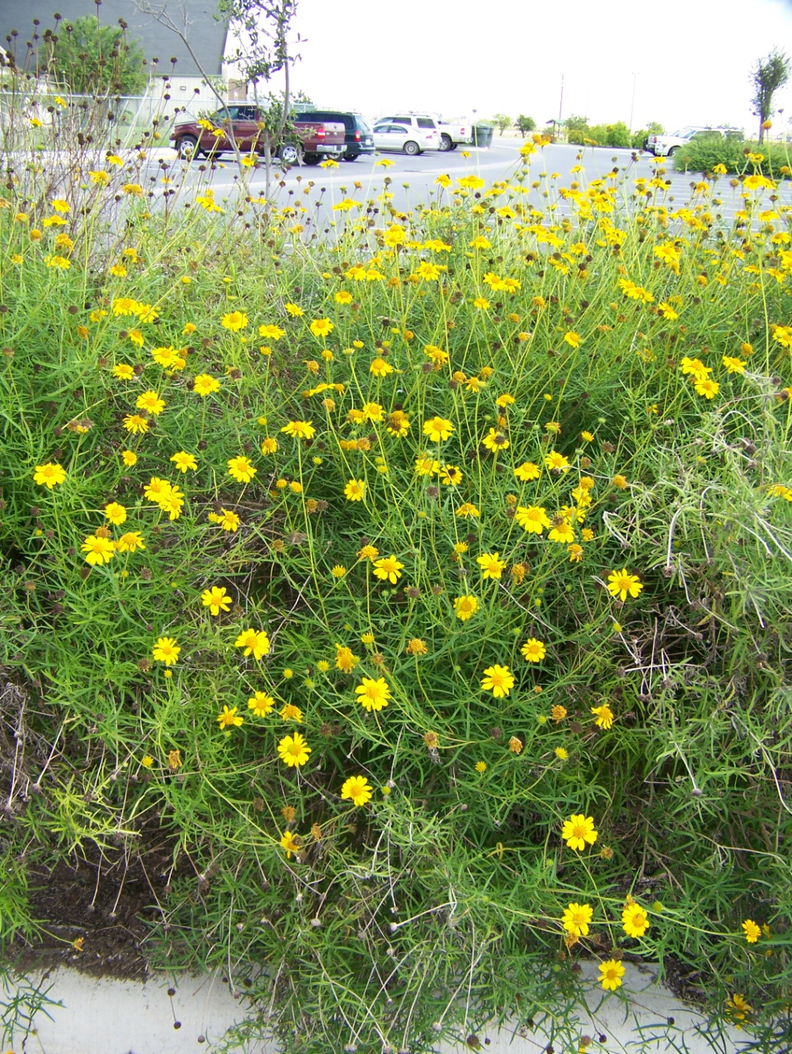
Drought Tolerant/Native Plants

Slide 17
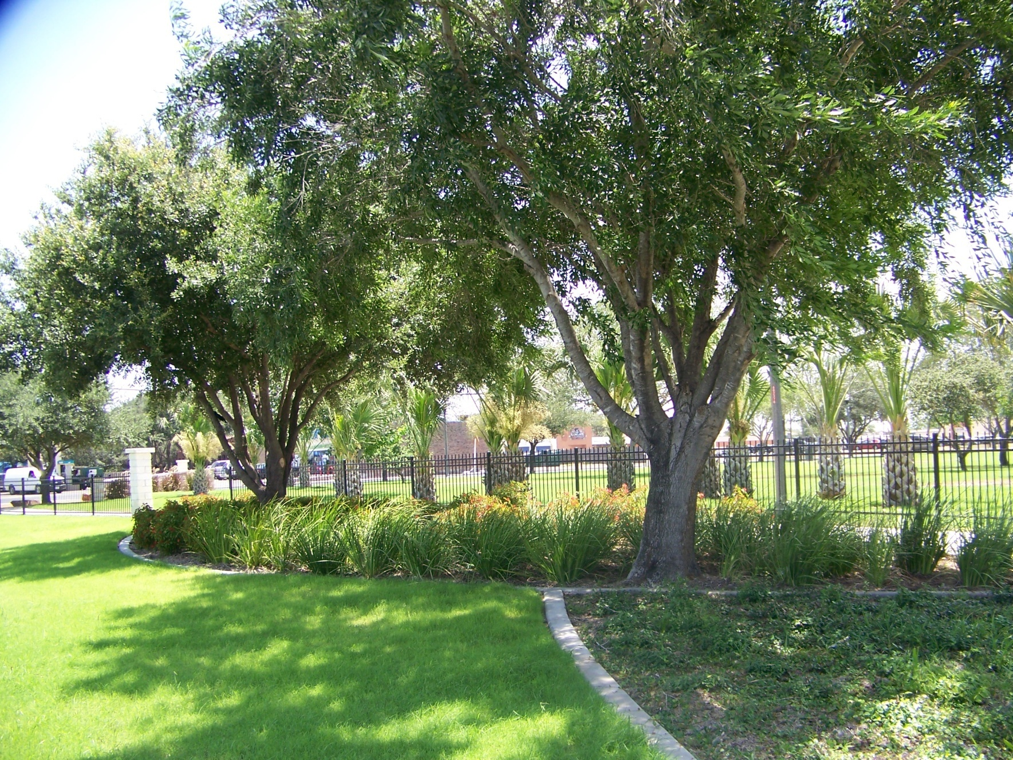
Native Trees/Shaded Beds/Reduce Turf

Slide 18
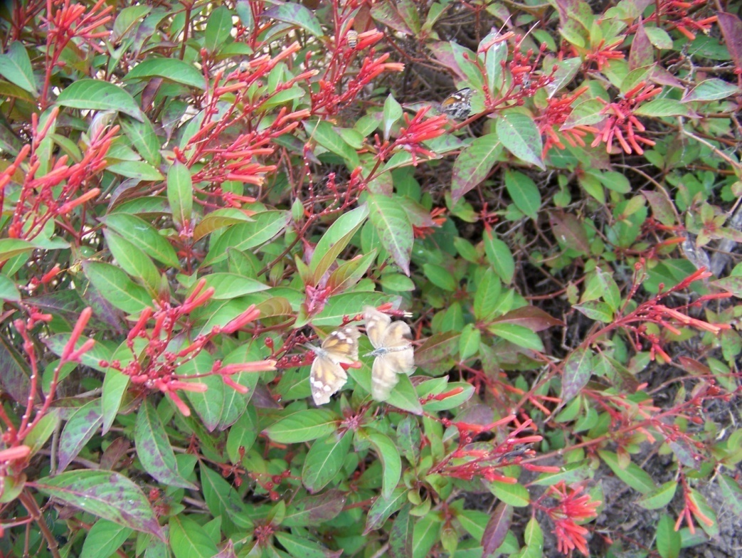
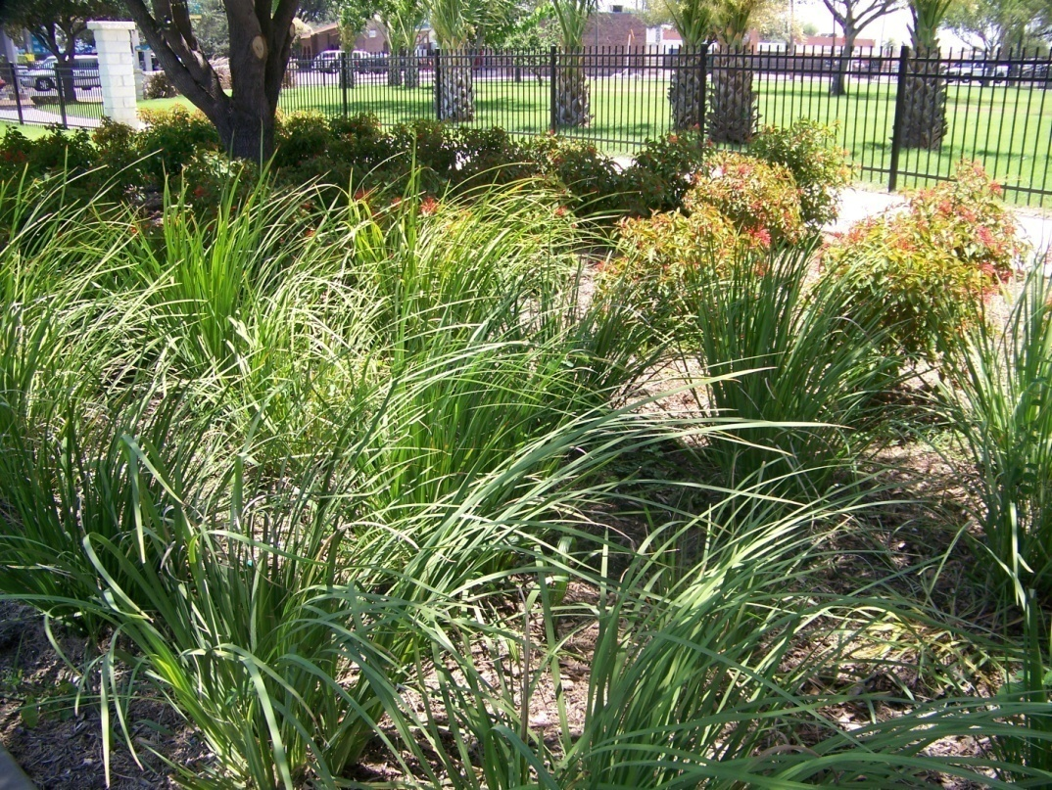
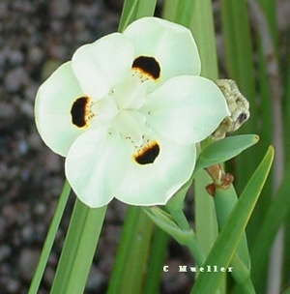
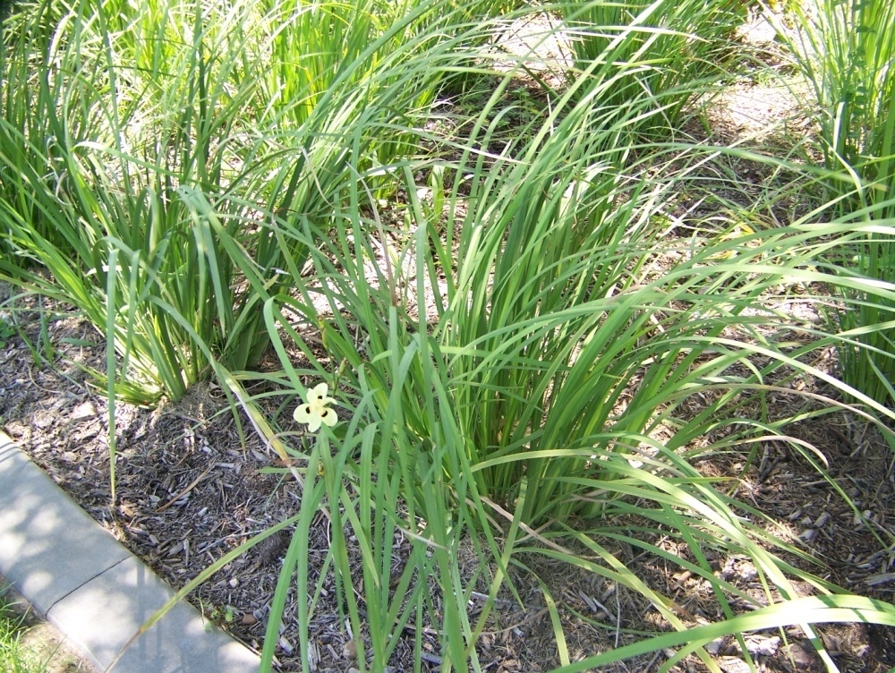

Slide 19
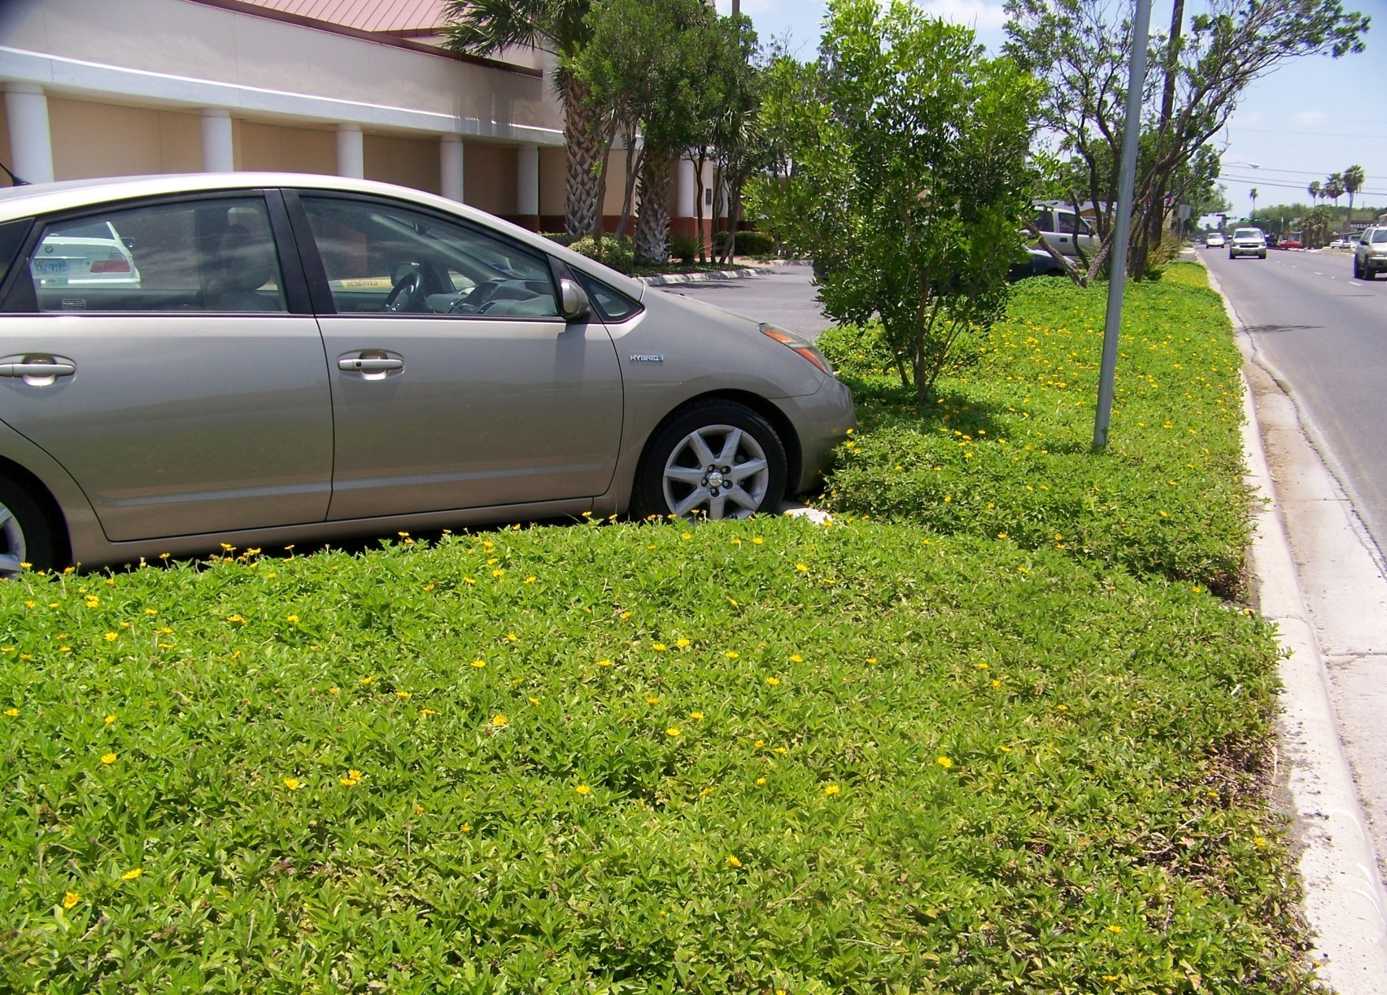
Use Ground Covers

Slide 20
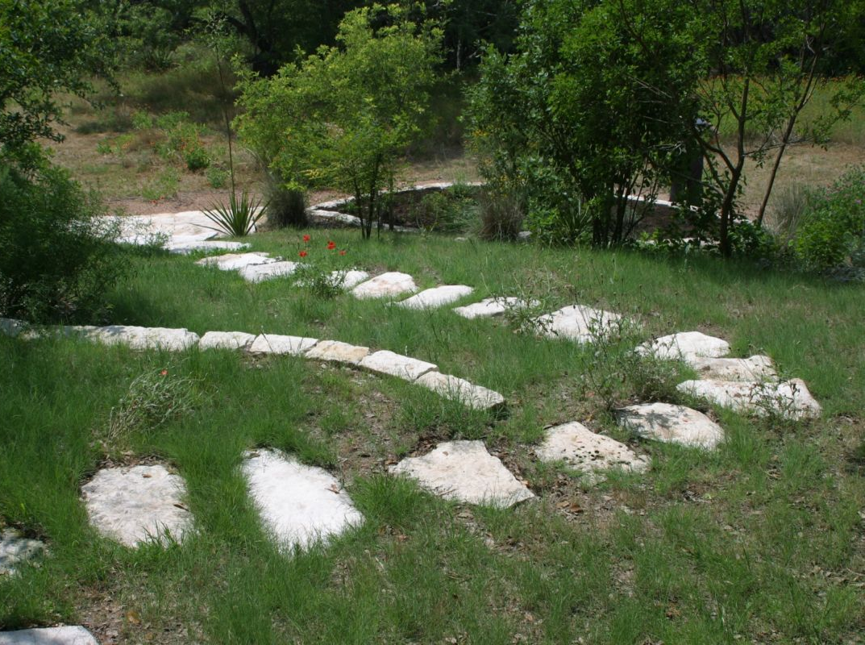
“Non-Irrigated” Natural Areas

Slide 21
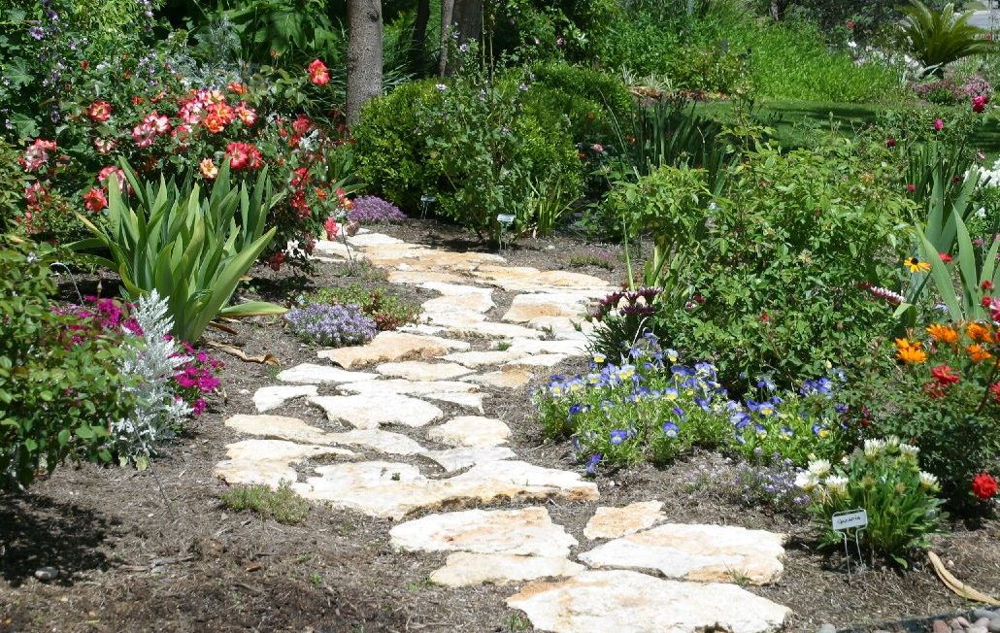
Minimize High Water Use Areas

Slide 22
Water-Wise…
Design
Installation

Slide 23
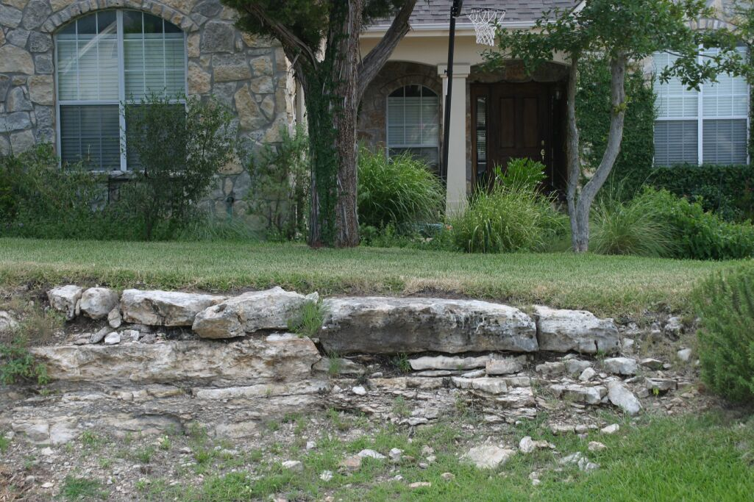
Soil Depth

Slide 24
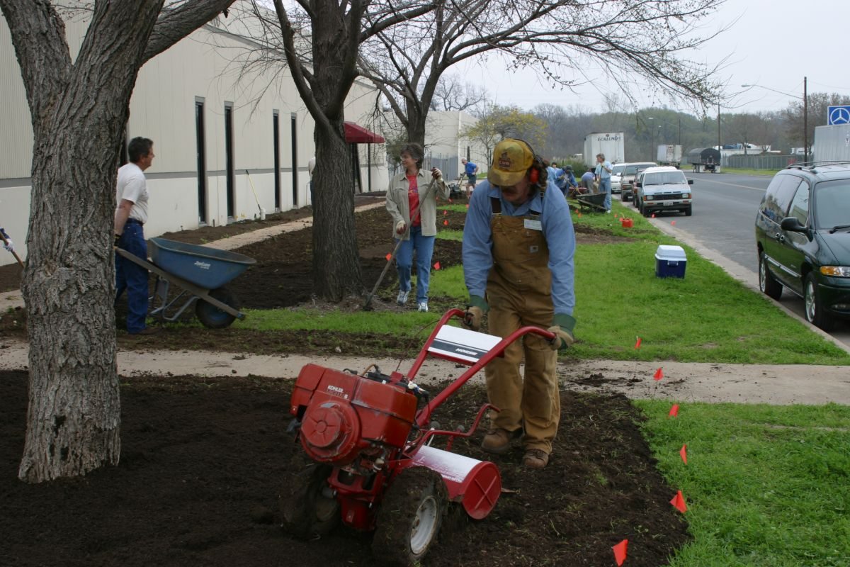
Soil Preparation

Slide 25
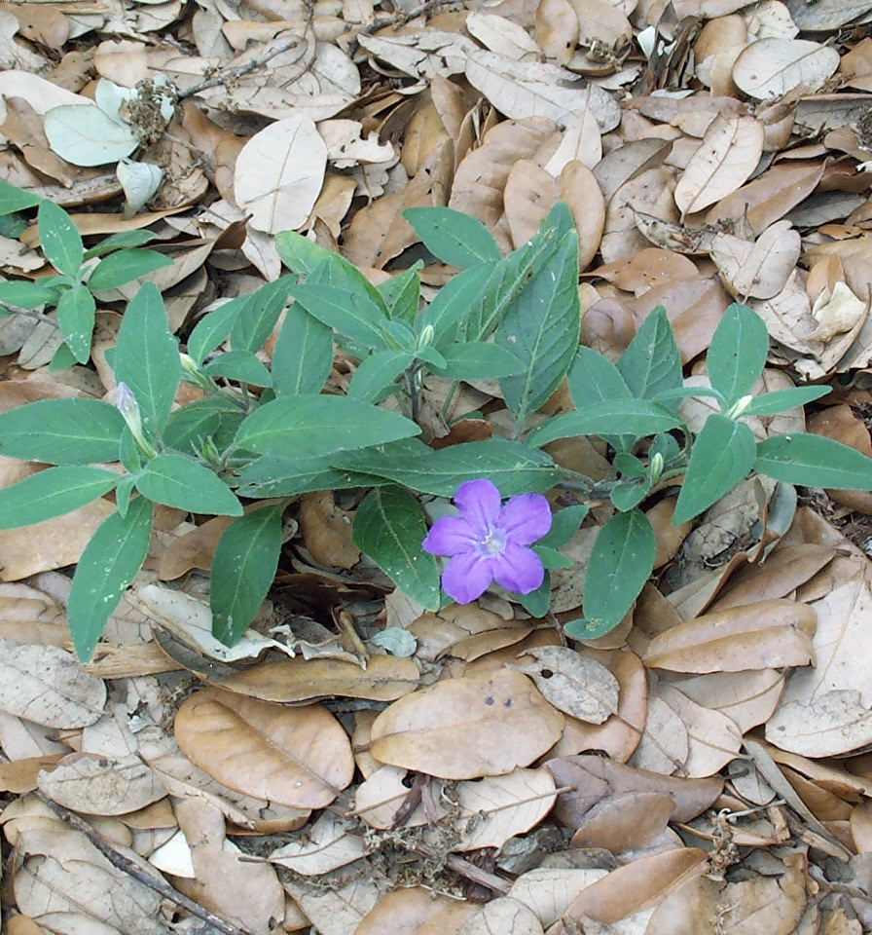
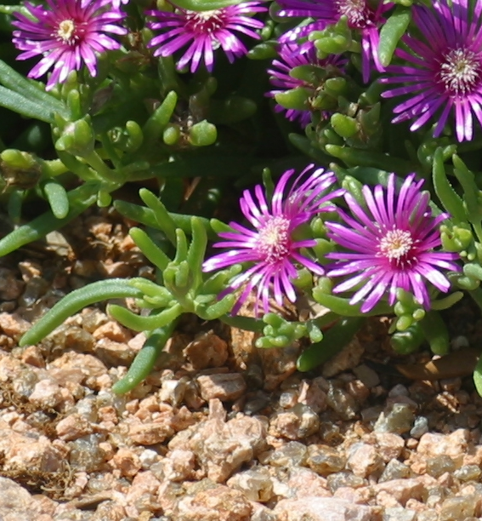
Mulching

Slide 26
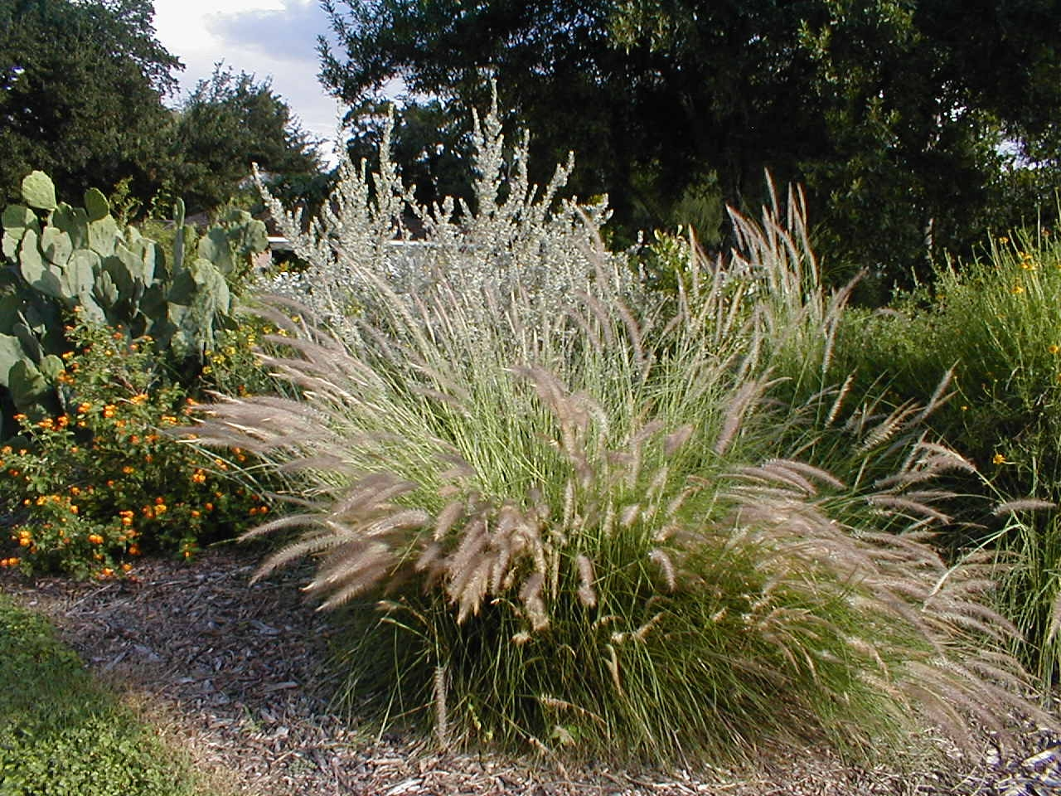
Mulching

Slide 27
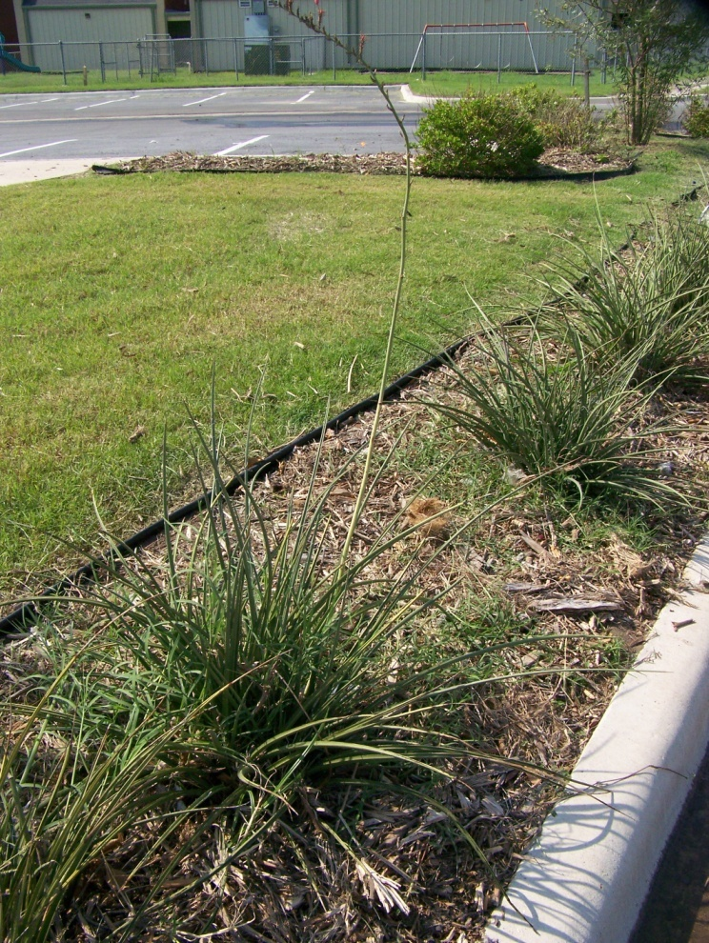
Mulch
Conserves Soil Moisture
Reduces Stress - Root Zone
Reduces Weeds – 3” – 4”
Need Apply 2 to 3 times/yr

Slide 28
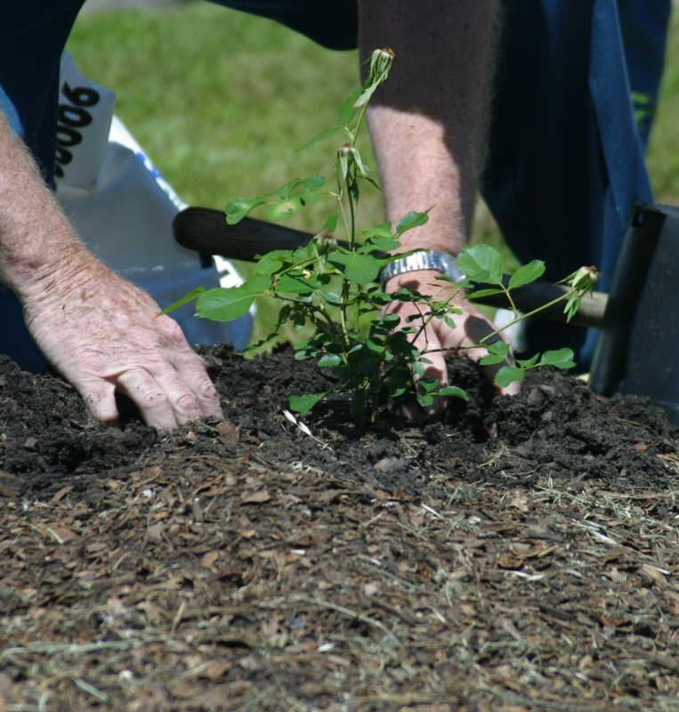
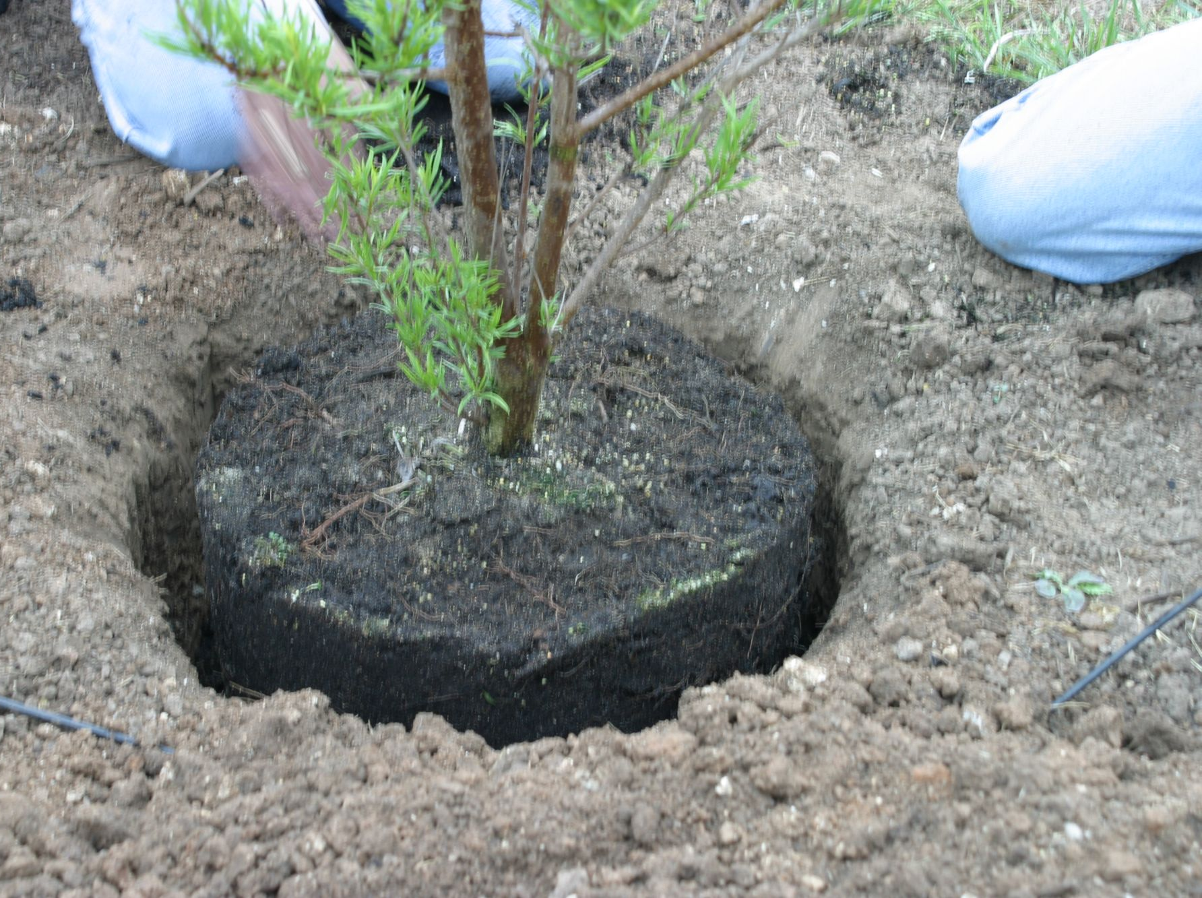
Fall Planting

Slide 29
Water-Wise…
Design
Installation
Plants

Slide 30
What Are Drought Tolerant Plants?
  Plants that survive extended drought.
  or
  Plants that look good during a drought.

Slide 31
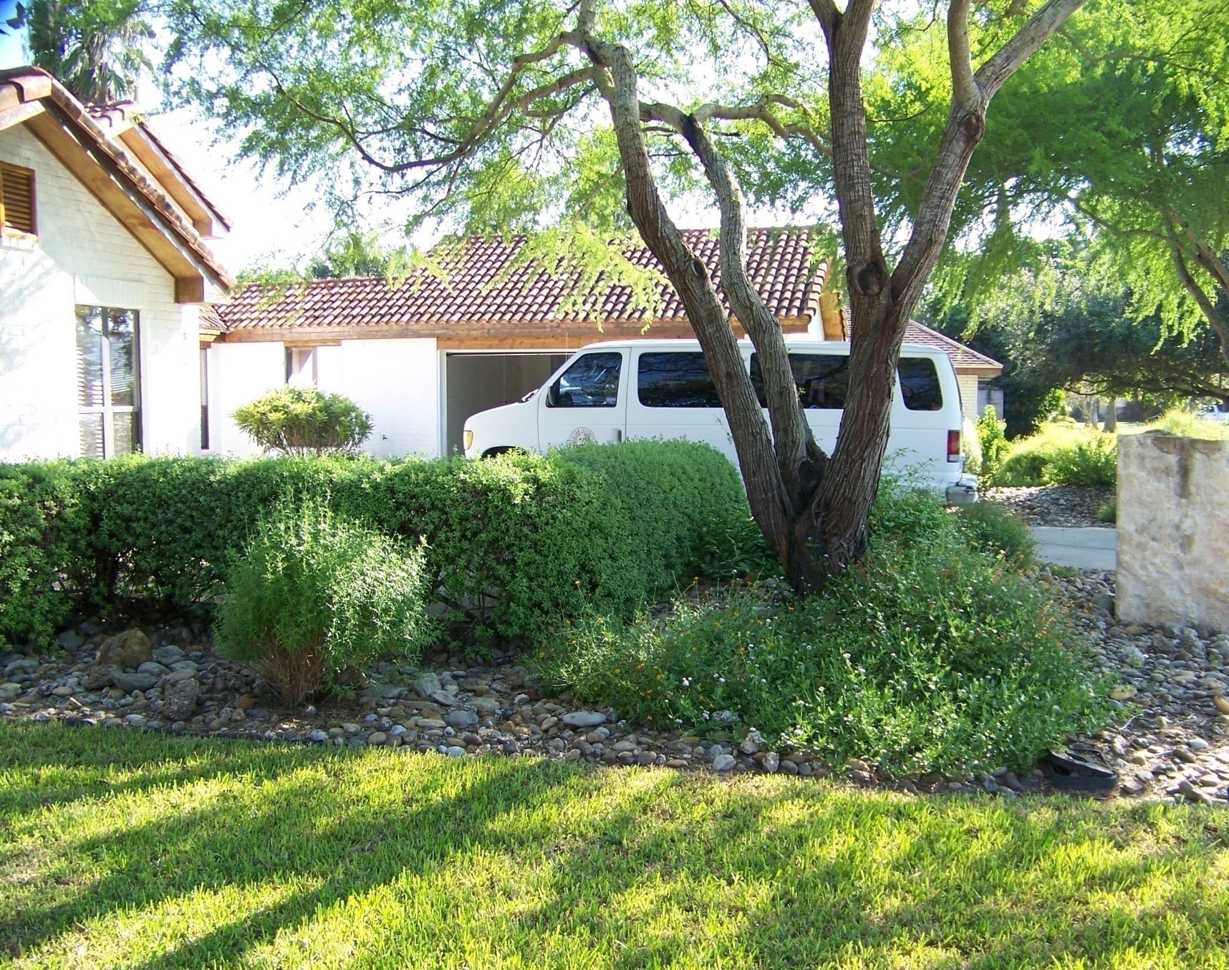
Huisache
(Acacia farnesiana)
Huisache
(Acacia farnesiana)

Slide 32
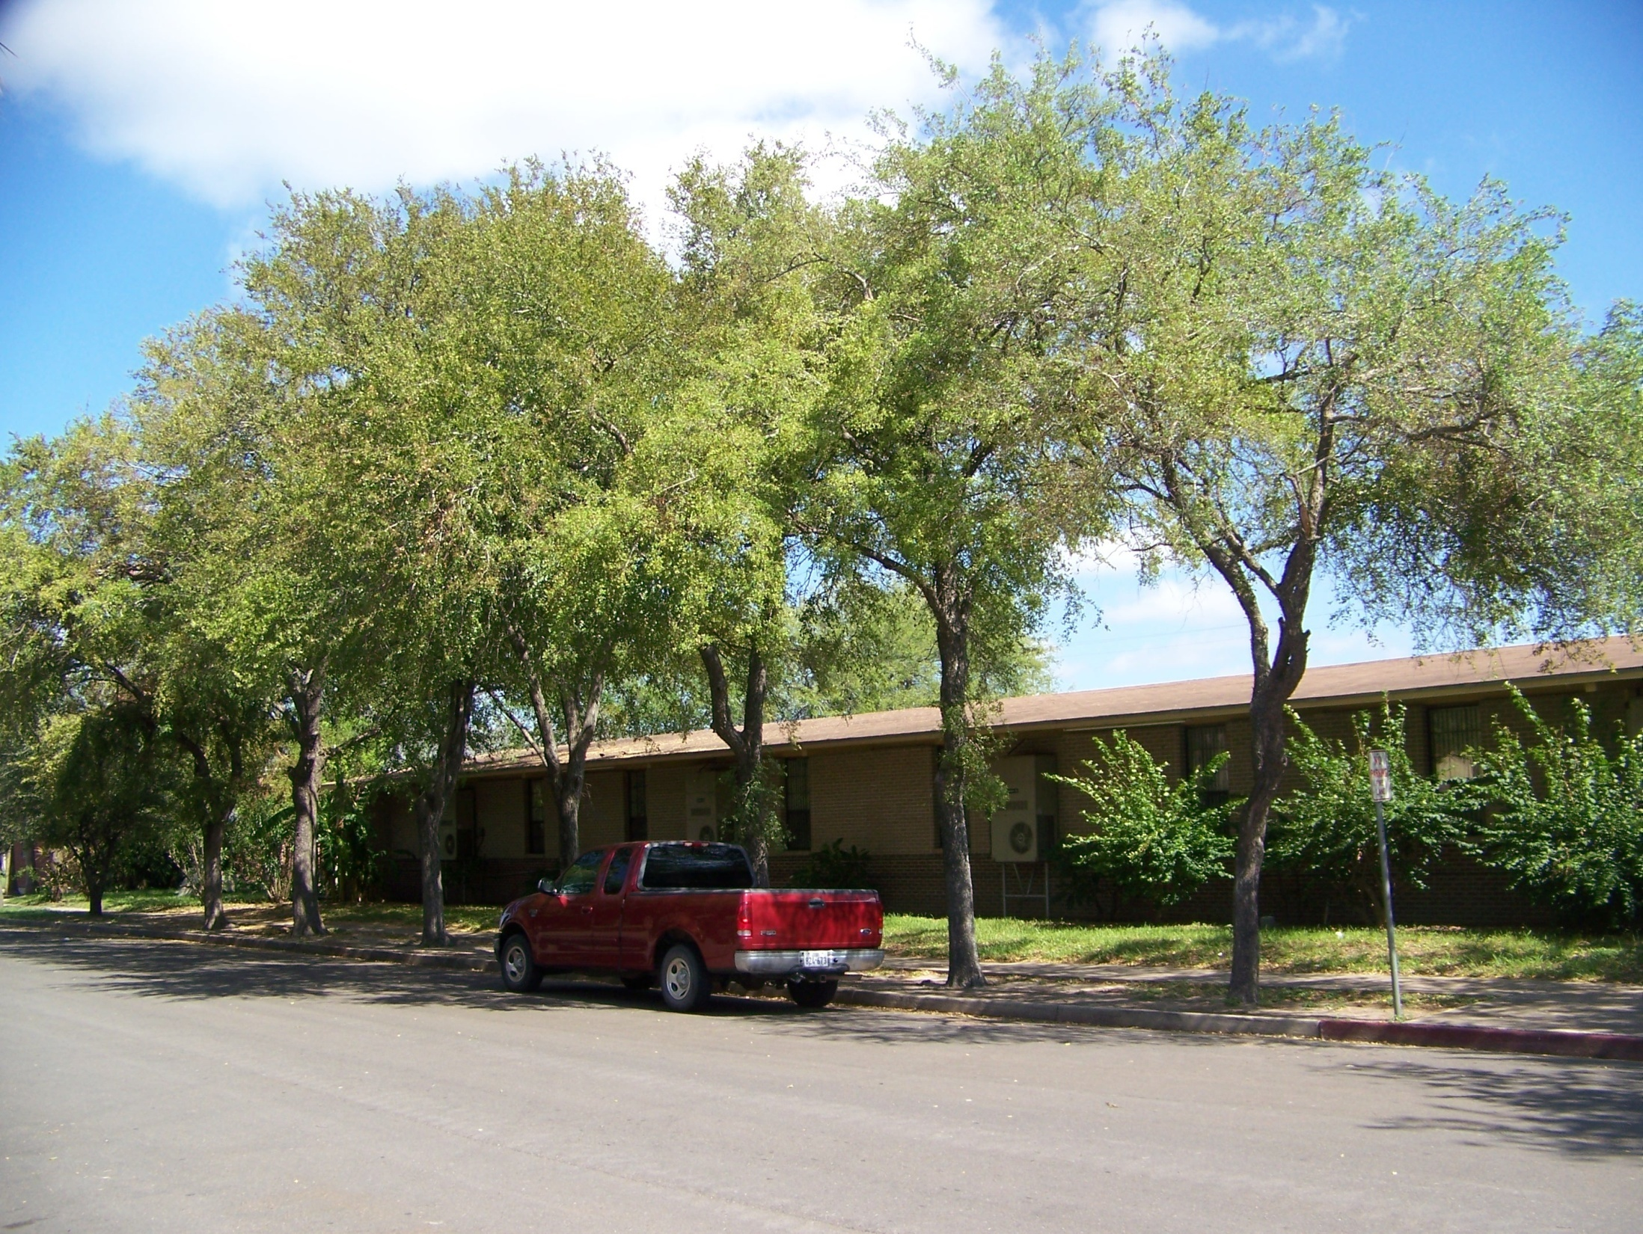
Cedar Elm

Slide 33
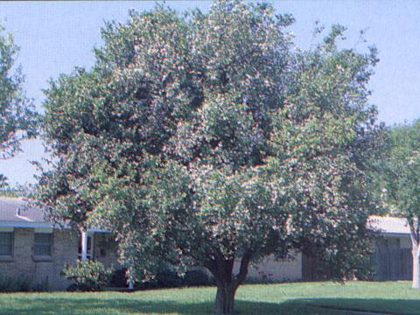
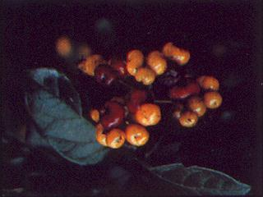
Anacua
(Anacua ehretiaana)

Slide 34
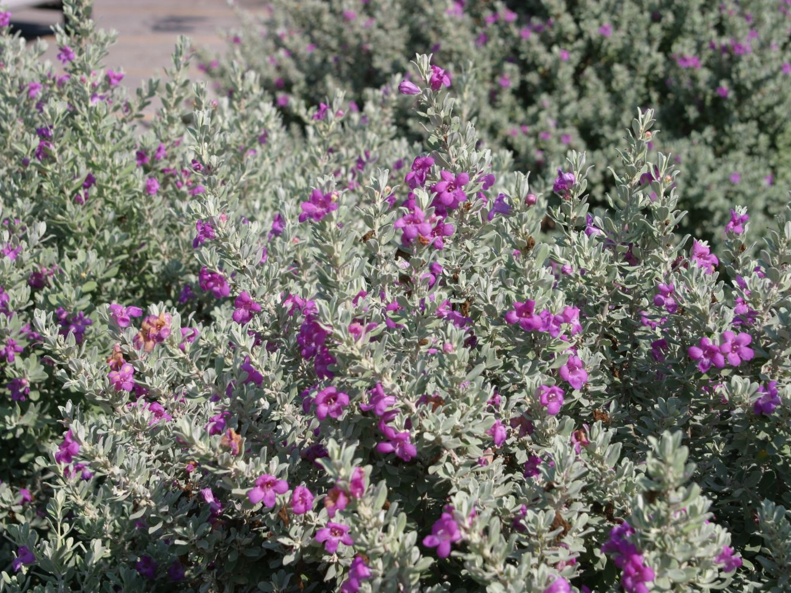
Cenizo (Leucophyllum frutescens)

Slide 35
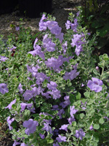
Lowery’s Legacy Cencizo
Leucophyllum langmaniae

Slide 36
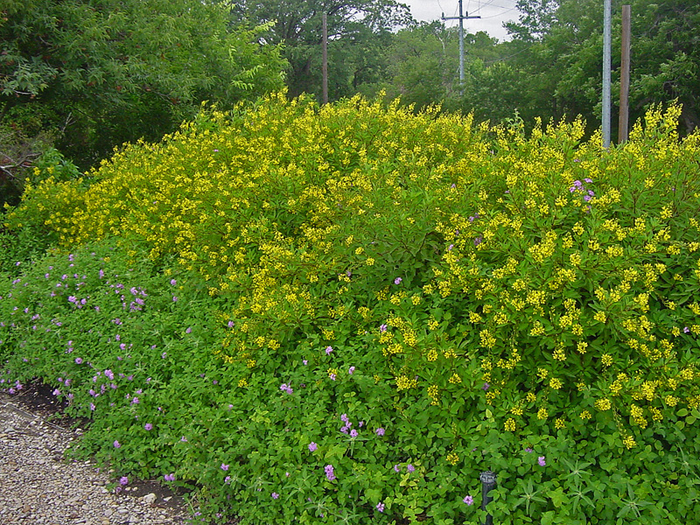
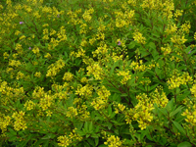
Shower of Gold
Galphimia glauca

Slide 37
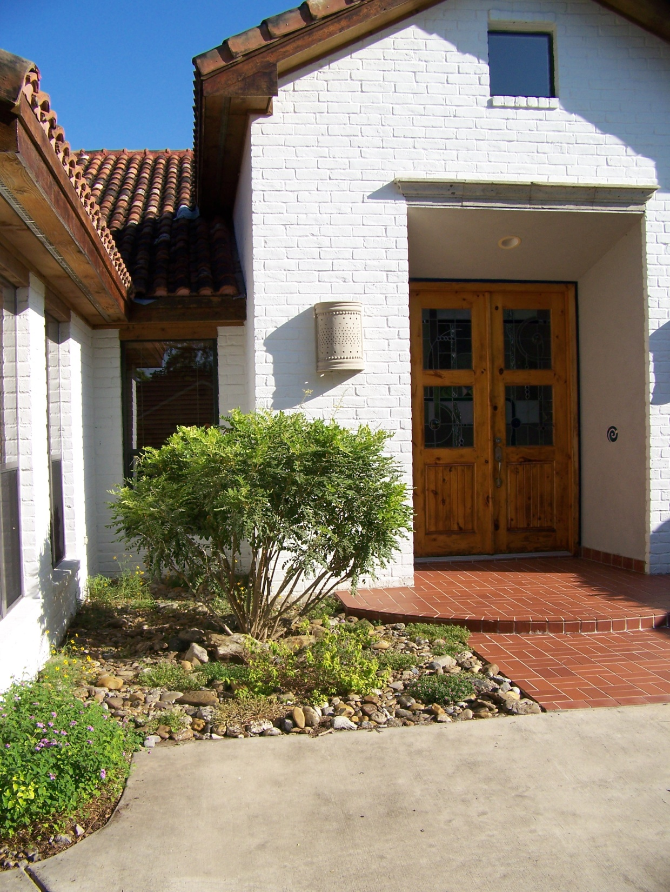
Yellow Sophora
Sophora
Tomentosa, var. occidentalis

Slide 38
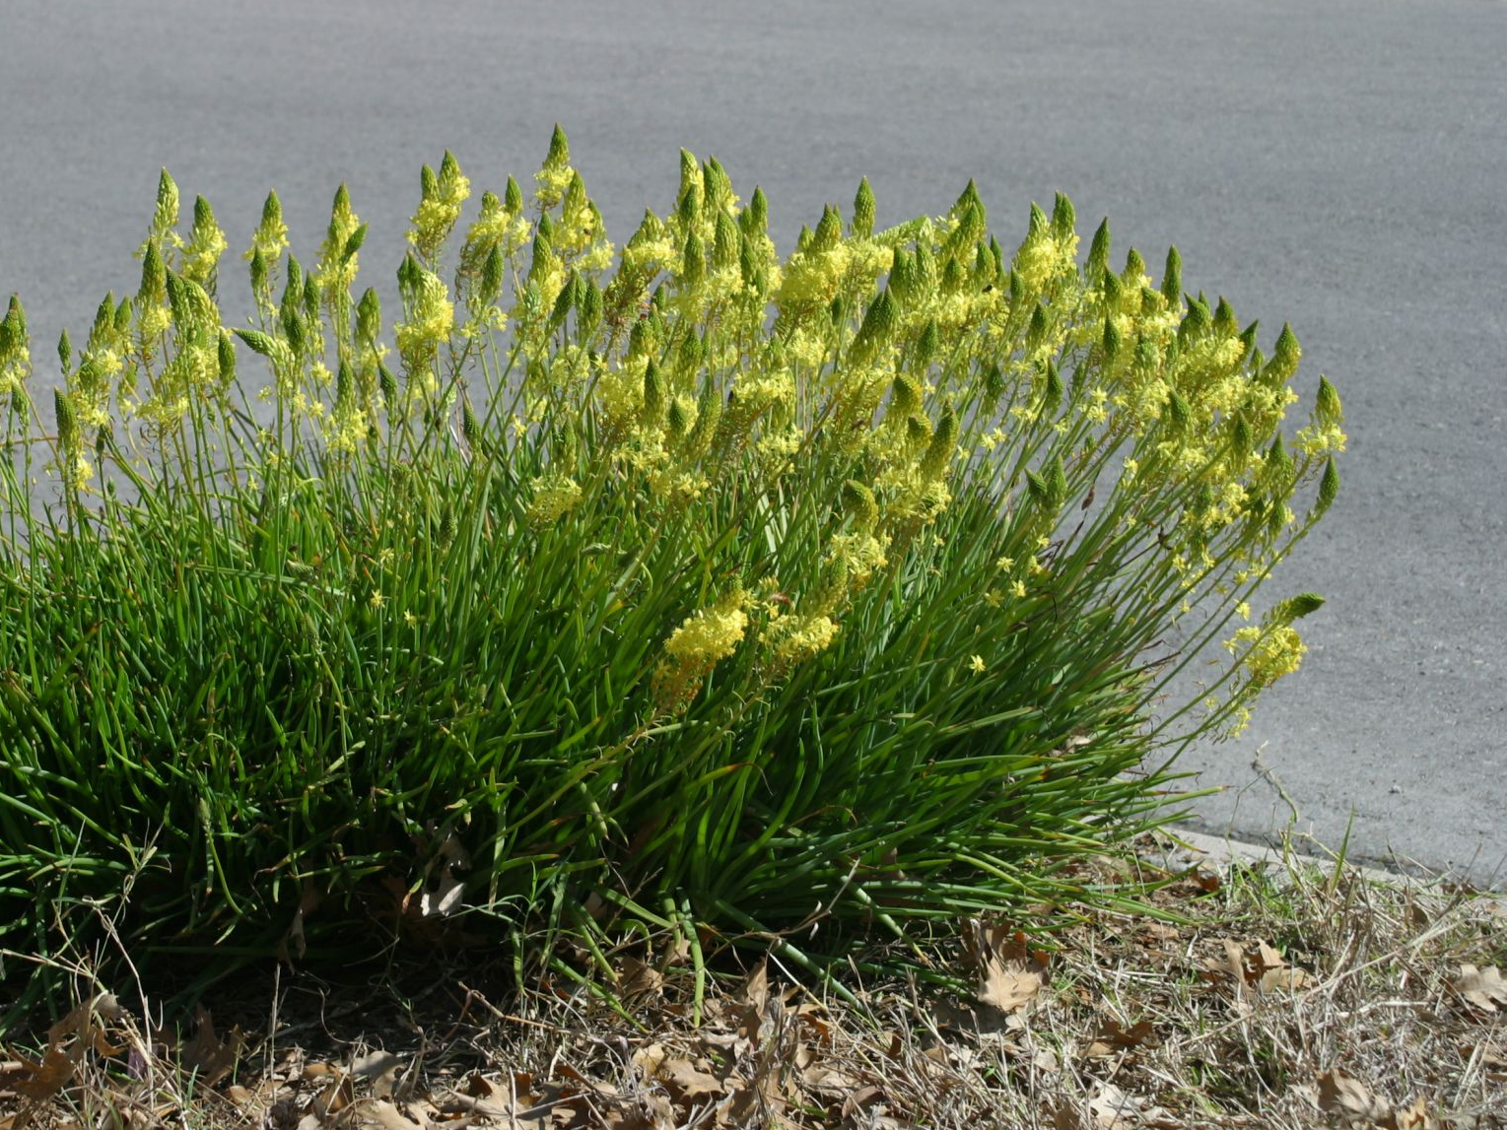
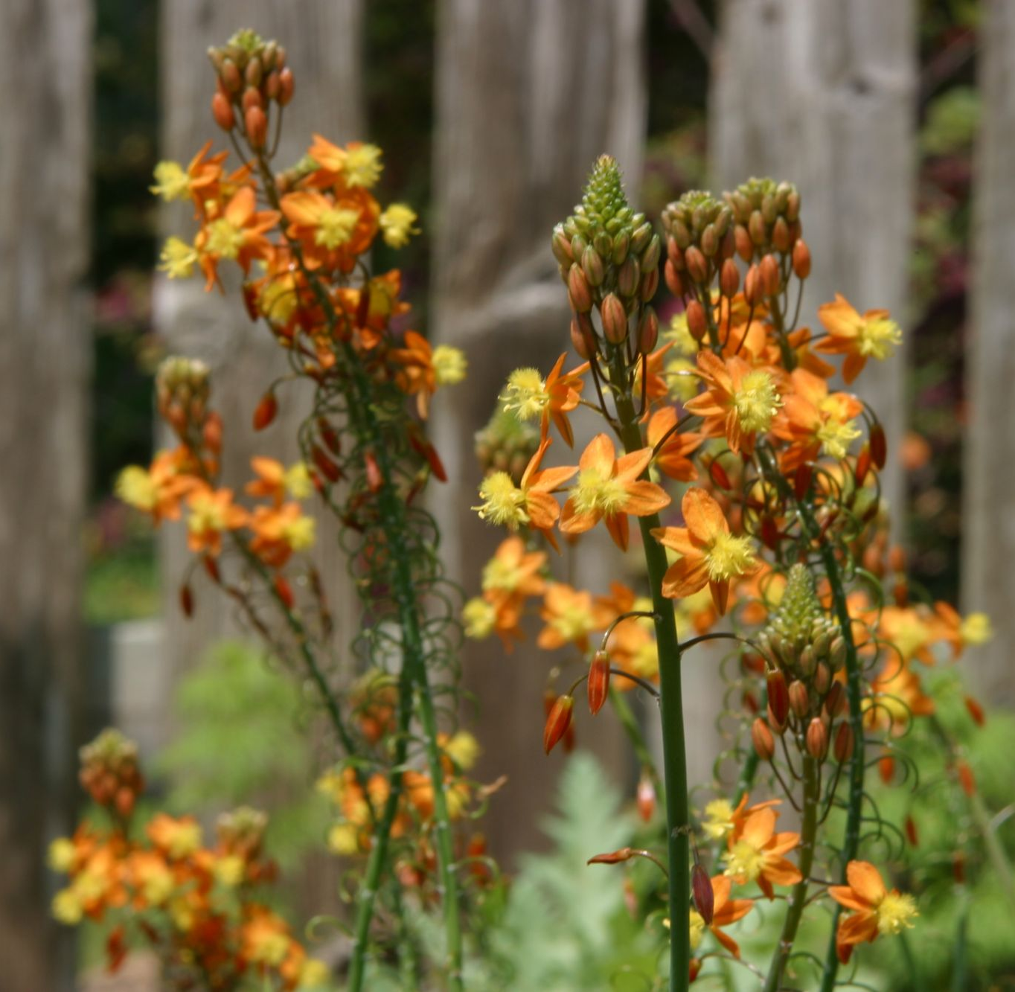
Bulbine

Slide 39
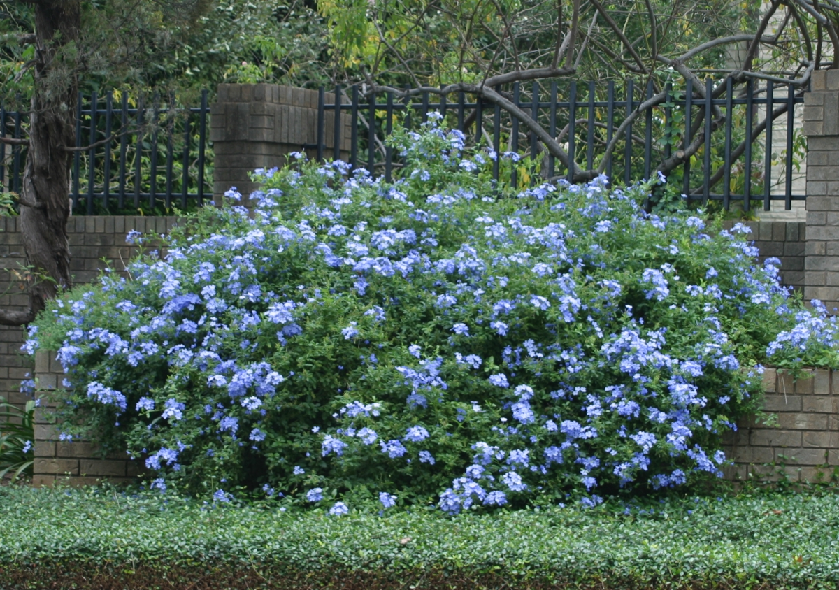
Plumbago

Slide 40
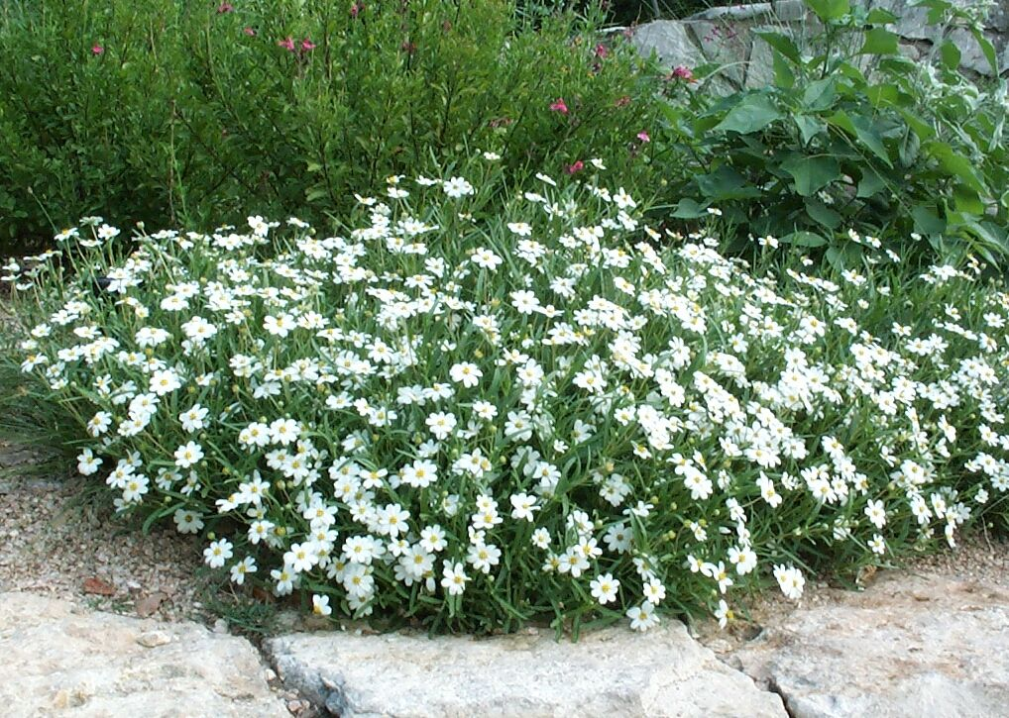
Blackfoot Daisy (Melampodium leucanthum)

Slide 41
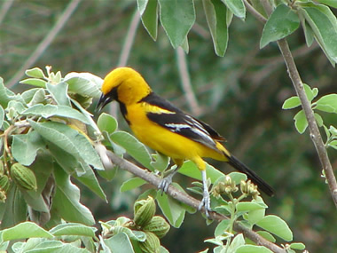
Natives - Thrive & Support Wildlife

Slide 42
Water-Wise…
Design
Installation
Plants
Technologies

Slide 43
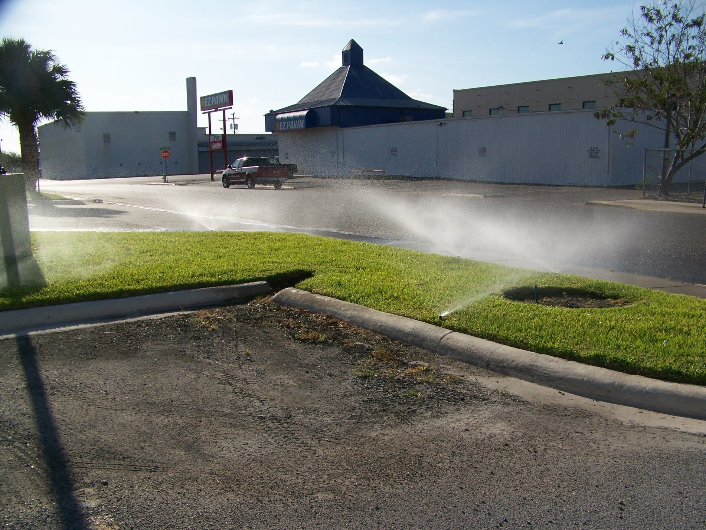

Slide 44
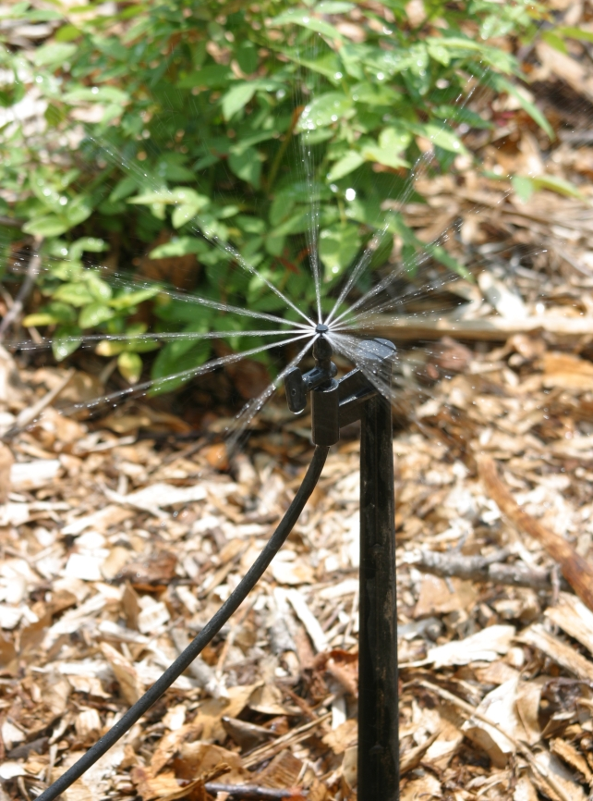
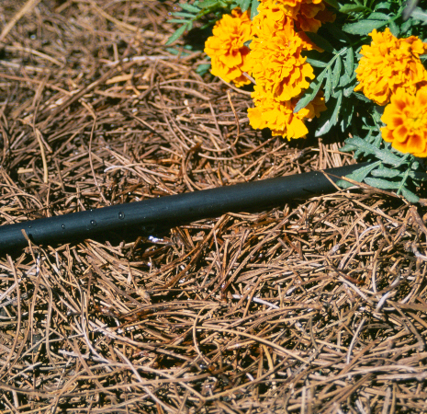
Drip & Microspray Irrigation

Slide 45
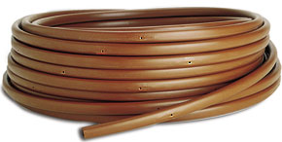
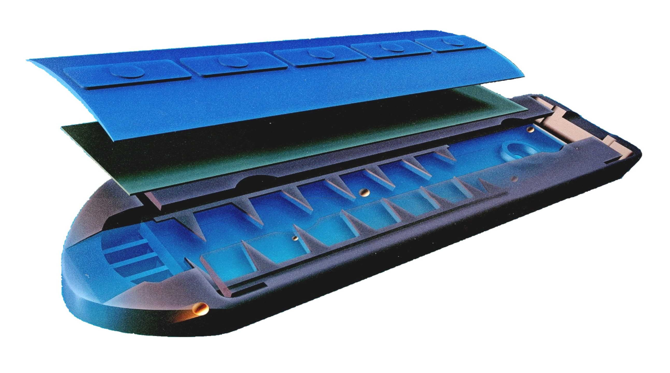
Drip Irrigation
Pressure compensating,
self-flushing emitter

Slide 46
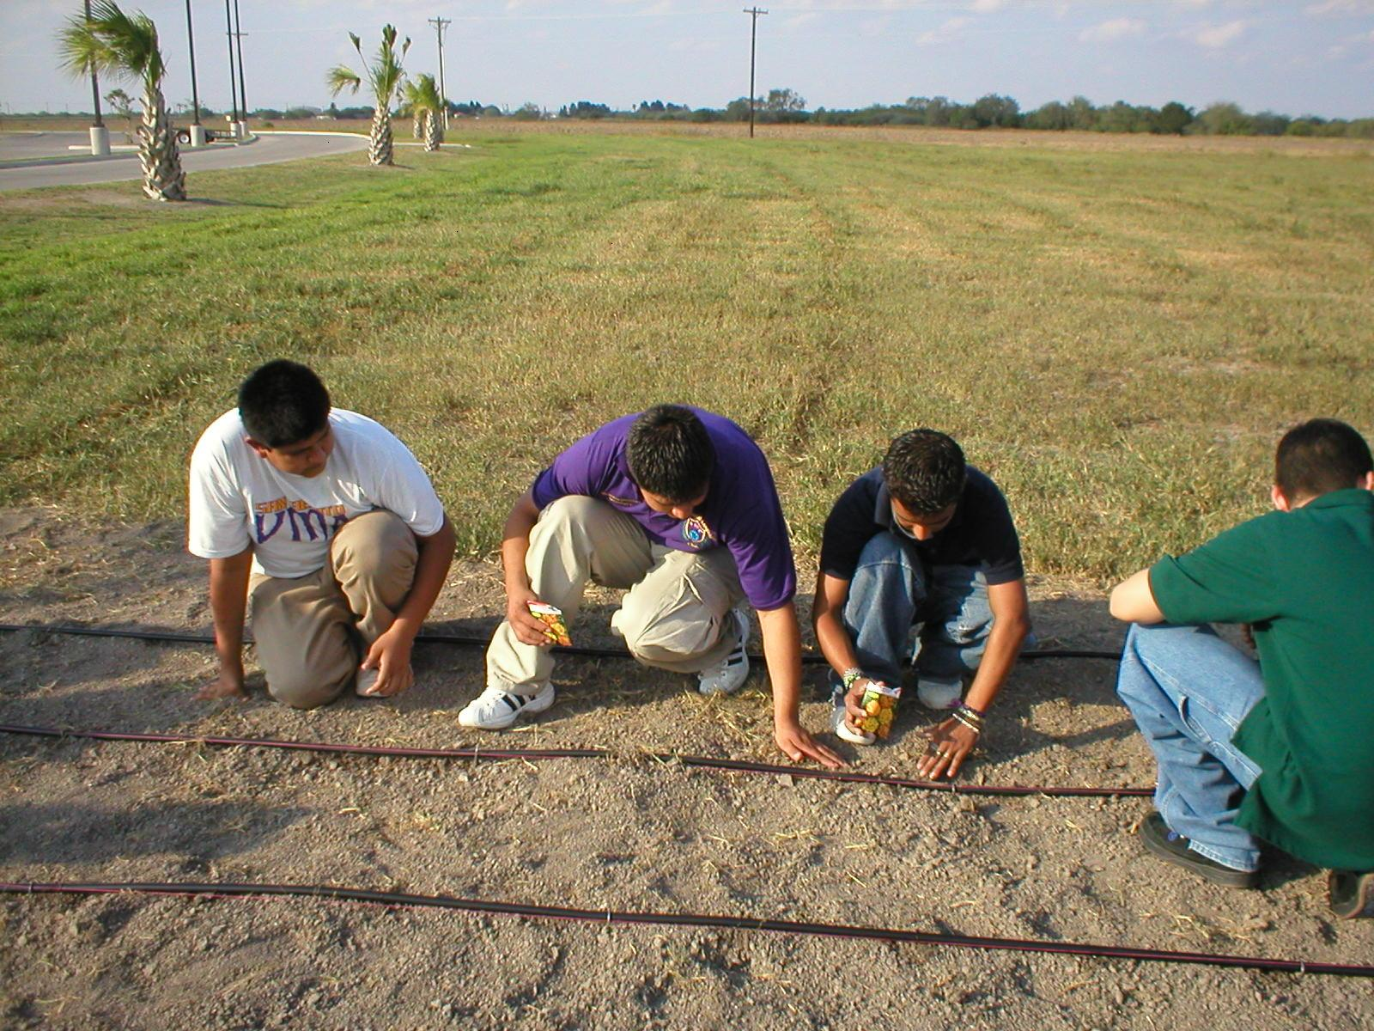

Slide 47
Water-Wise…
Design
Installation
Plants
Technologies
Alternative Sources

Slide 48
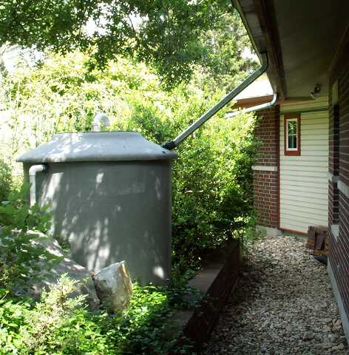
Rainwater Collection
1 inch of rain
on a 2000
square-foot home
= 1,200 gallons
of water

Slide 49
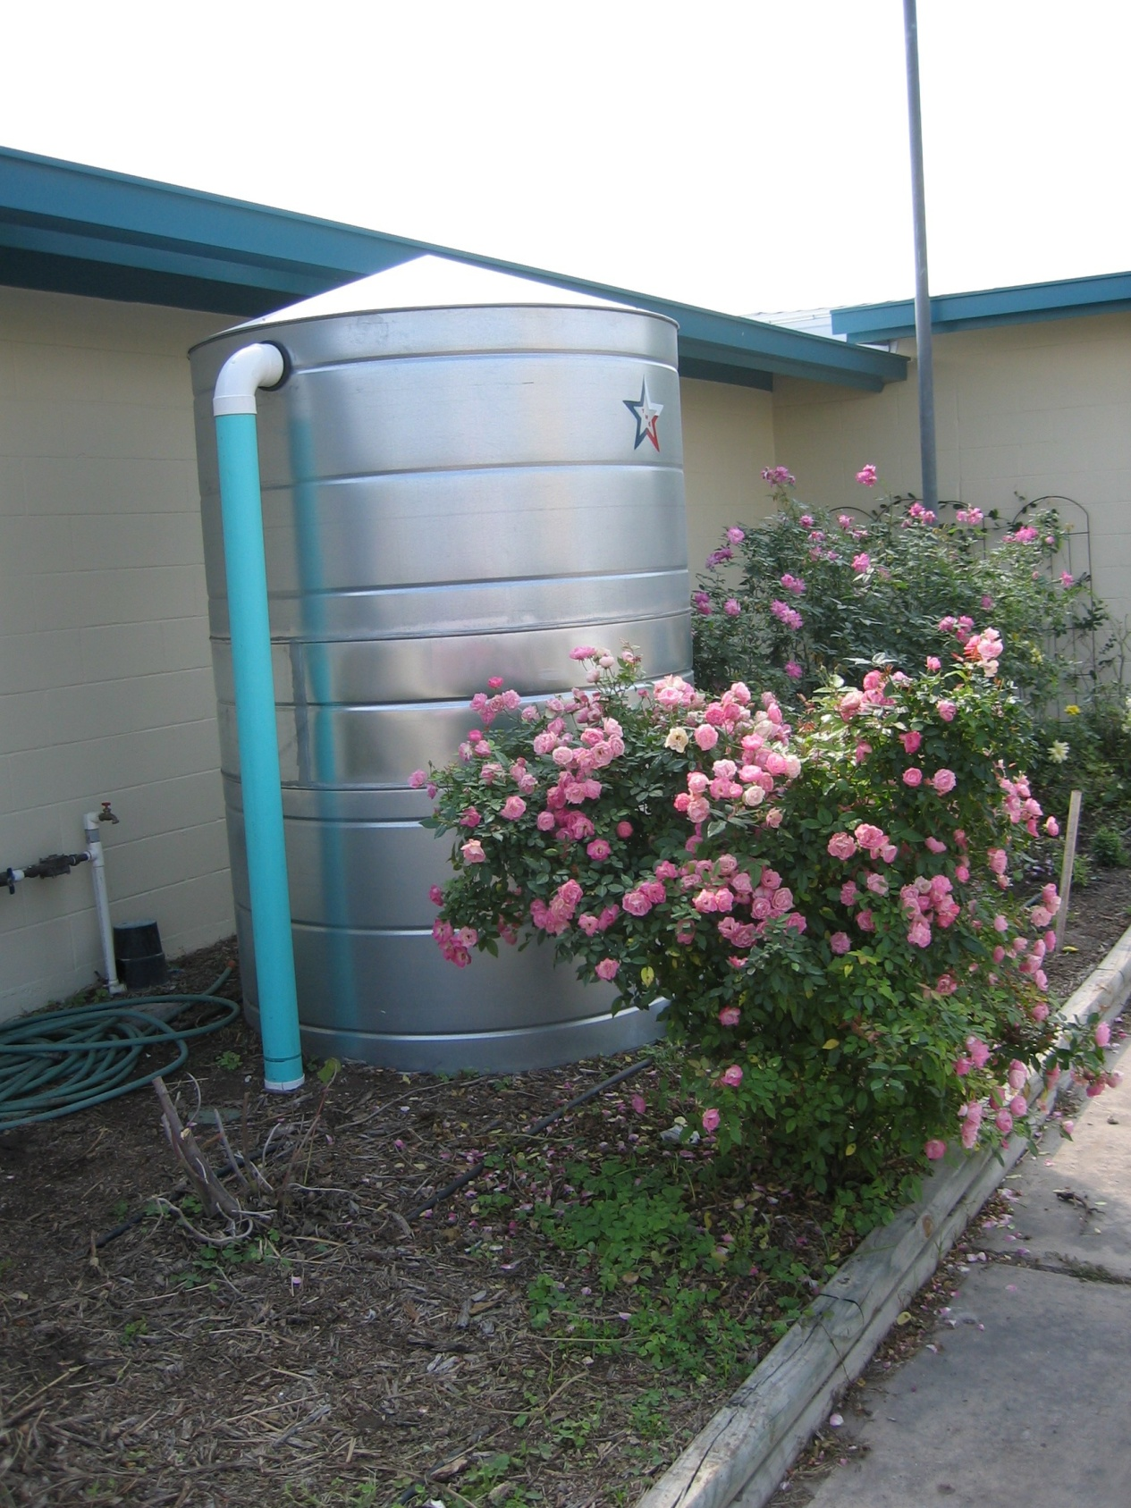

Slide 50
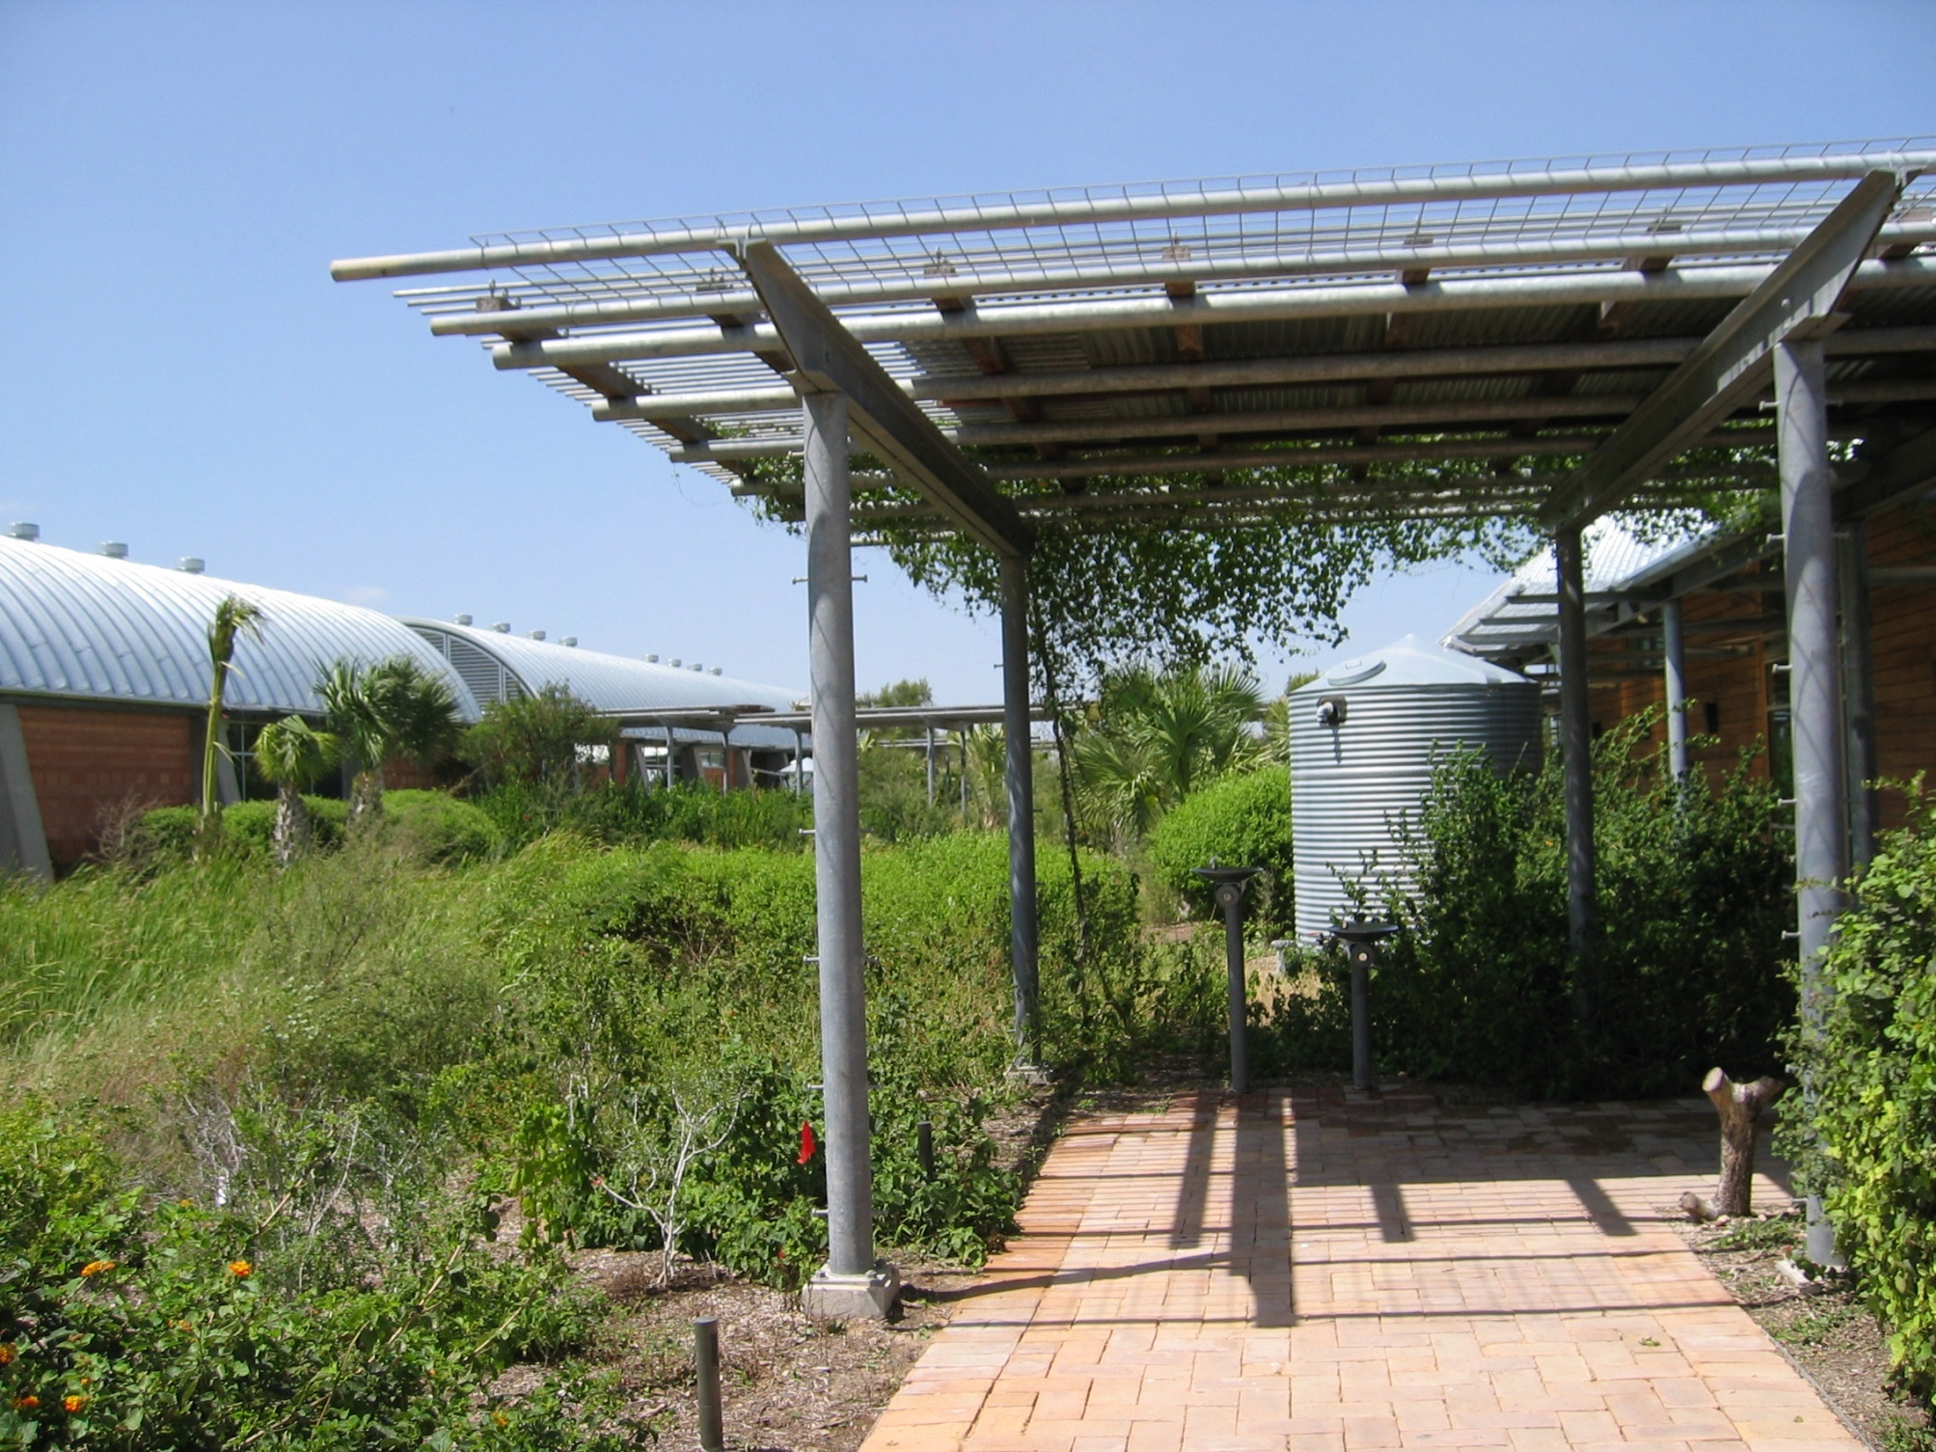

Slide 51
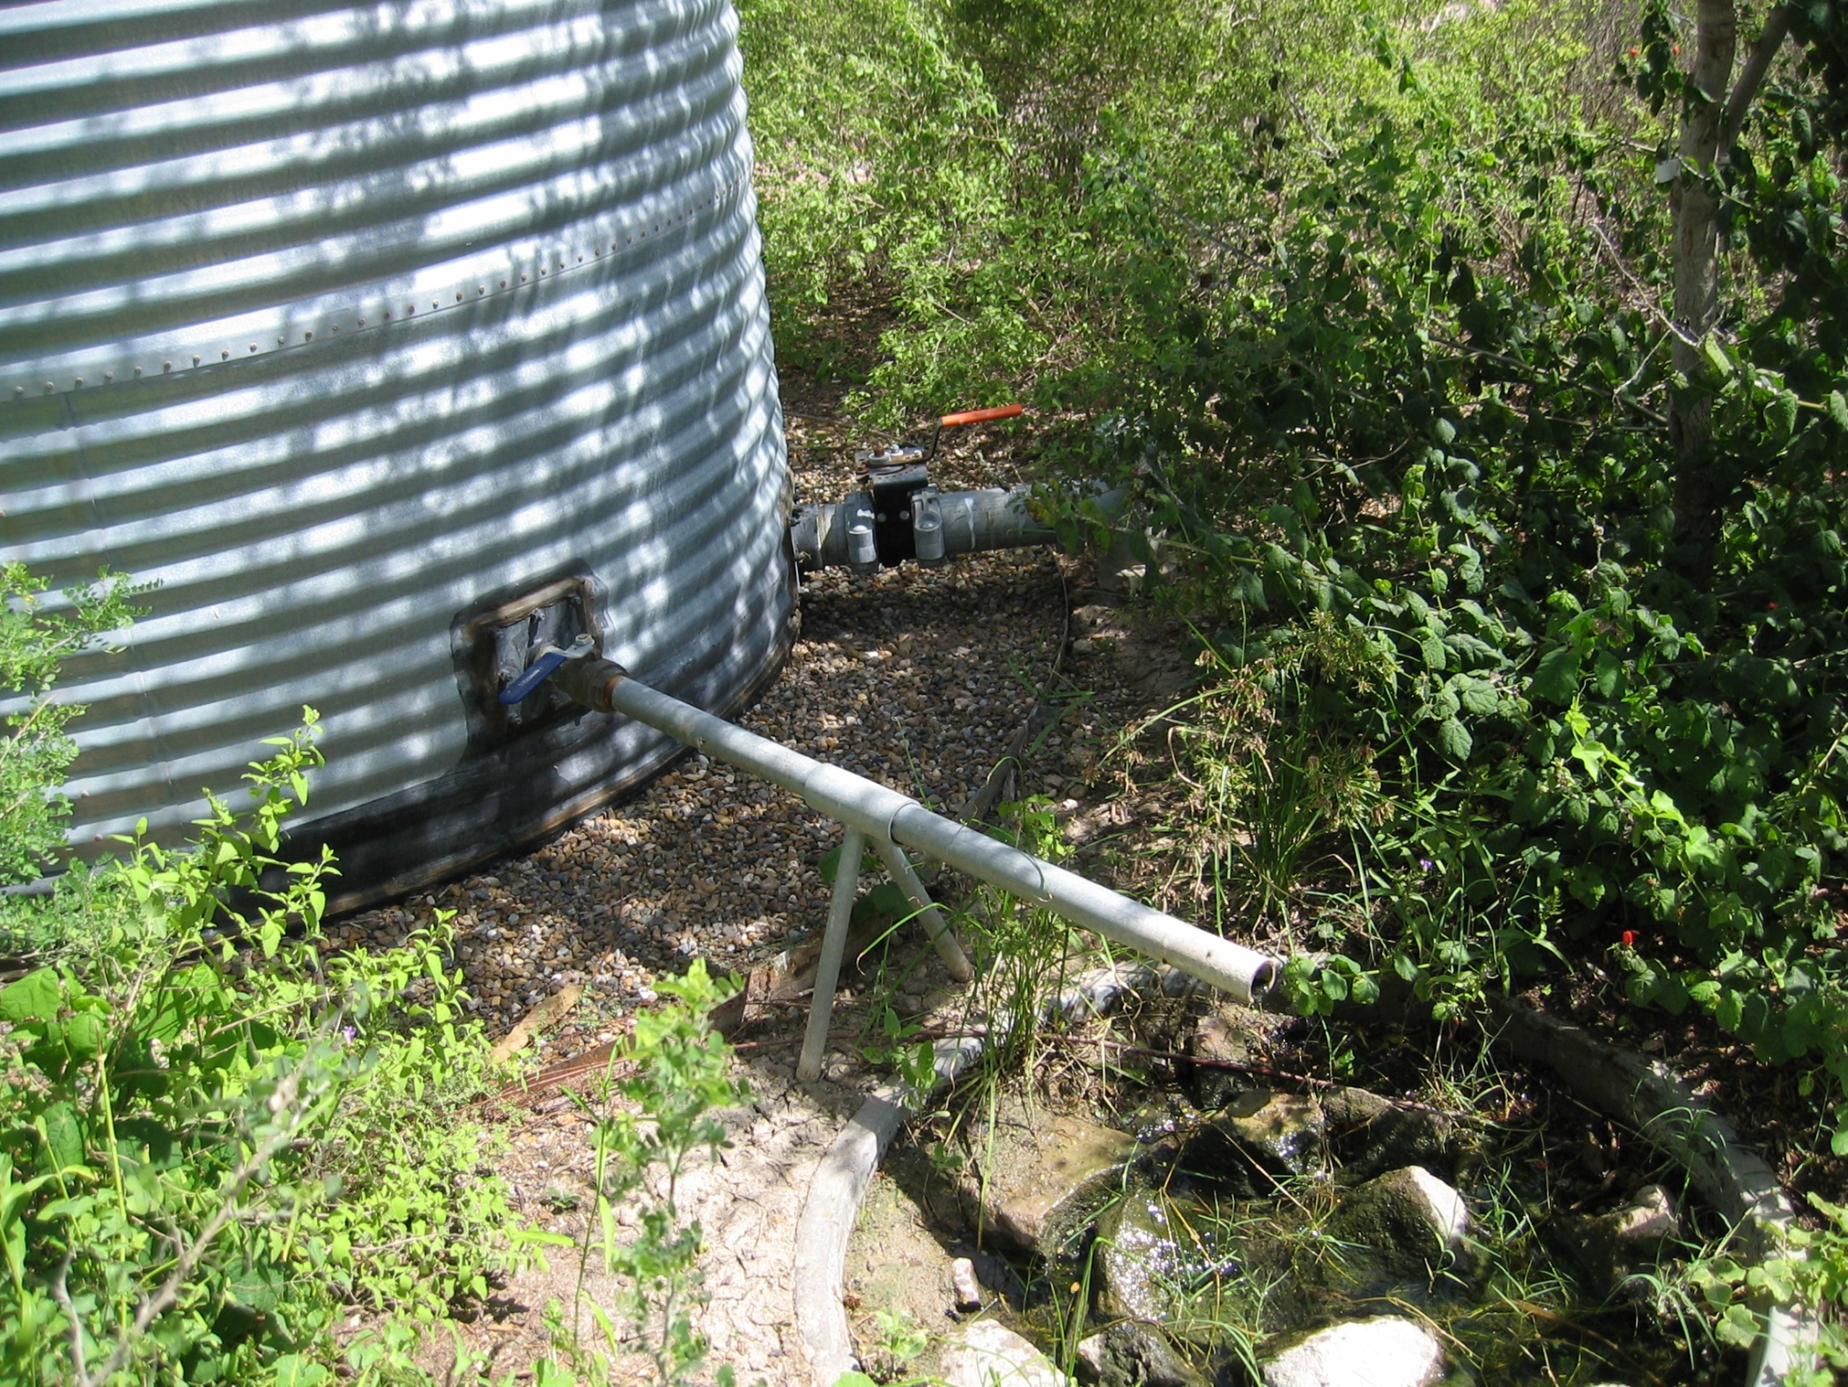

Slide 52


Slide 53
Resources
Texas AgriLife Extension
http://aggie-horticulture.edu, “Earth Kind”
WaterWise Council of Texas
www.waterwisetexas.org
The Texas Evapotranspiration Web Site
texaset.tamu.edu
Texas Guide to Rainwater Harvesting
www.twdb.state.tx.us/publications/reports/RainHarv.pdf
Common Grey Water Errors and Preferred Practices
http://www.oasisdesign.net/greywater/misinfo/

Slide 54
Acknowledgement:
Special Thanks to Skip Richter,
CEA-Horticulture
Texas AgriLife Extension Service
Harris County, Texas

