Slide 1
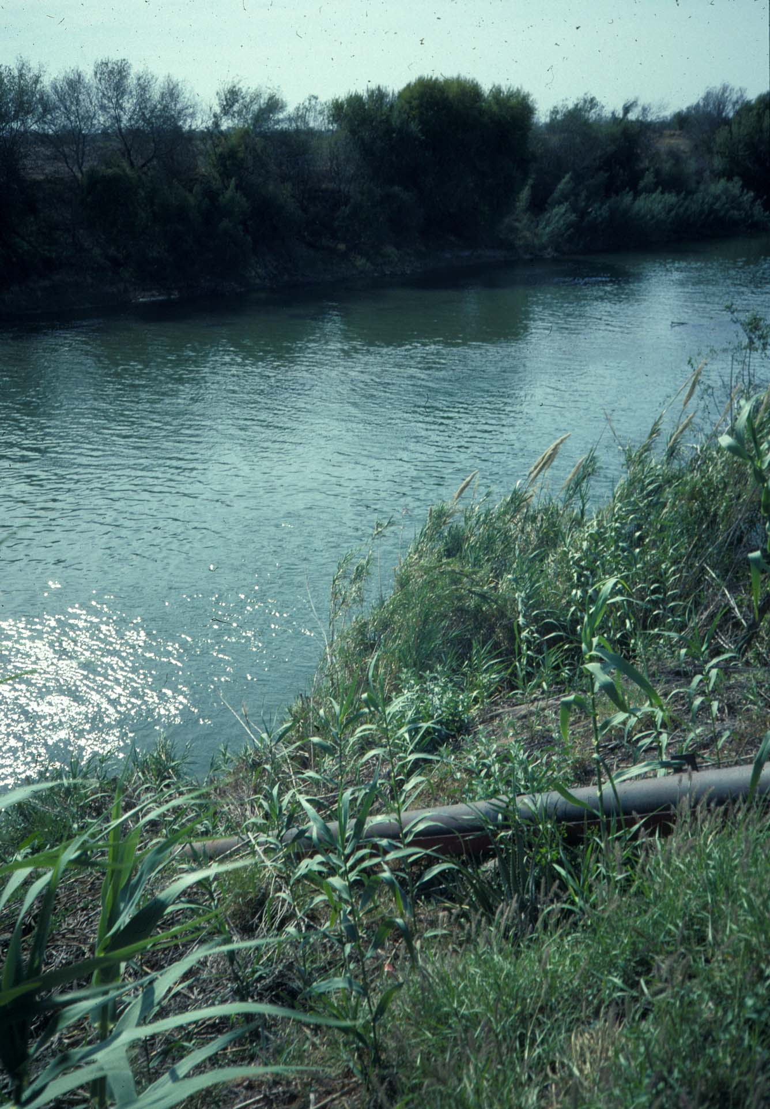
Vegetable Irrigation Quality and Implications for Food Safety
Juan Anciso Ph.D.,
Extension Vegetable Specialist
Texas A&M AgriLife Extension Service

Slide 2
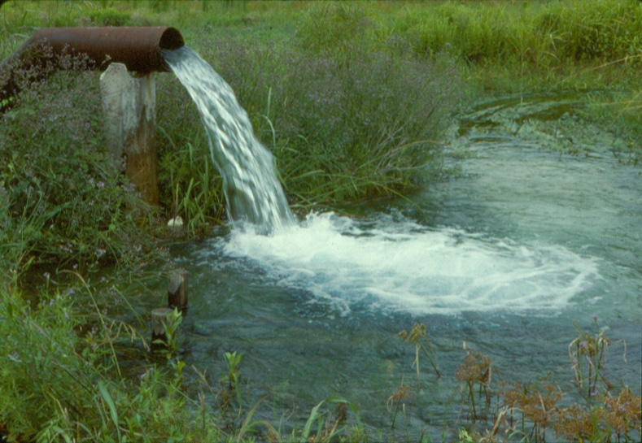
Agricultural Water
Irrigation Sources
Surface water may contain pathogens and parasites of humans but rarely exceeds a Class 4 of water salinity
Well (ground) water is less likely to harbor pathogens,
depending on depth,
but may contain pesticide, residues or heavy metals, and may
exceed a Class 5 of
water salinity
Notes:
Irrigation water is usually spread across all of the production field as a result it can serve as an inoculation technique to contaminate all of the produce contained within the irrigated area.
Therefore water used for irrigation should also be tested frequently.

Slide 3
Conductivity
Classes of Water | EC, dSm⁻¹ mmho ^{cm-1*} | TDS, ppm | Comments
Class 1, Excellent | 0-0.250 | 175 | No damage expected.
Class 2, Good | 0.250-0.750 | 175-525 | Damage to sensitive plants will occur.
Class 3, Permissible | 0.750-2.0 | 525-1400 | Damage to plants with low salinity tolerance will likely occur.
Class 4, Doubtful | 2.0-3.0 | 1400-2100 | Damage to plants with high tolerance to salinity may occur.
Class 5, Unsuitable | >3.0 | >2100 | Same as above but generally not recommended for crop use.
Based on Provin and Pitt Description of Water Analysis Parameters SCS-2002-10

Slide 4
Expected Yield with EC values
Vegetable | 100% | 90% | 75% | 50% | Salt | Boron
Cabbage | 1.2 | 1.9 | 2.9 | 4.6 | M | MT
Celery | 1.2 | 2.3 | 3.9 | 6.6 | MS | VT
Corn, sweet | 1.1 | 1.7 | 2.5 | 3.9 | MS | VT
Cucumber | 1.7 | 2.2 | 2.9 | 4.2 | MS | MS
Onion | 0.8 | 1.2 | 1.8 | 2.9 | S | S
Pepper | 1.0 | 1.5 | 2.2 | 3.4 | MS | MS
Spinach | 1.3 | 2.2 | 3.5 | 5.7 | MS | ---
Tomato | 1.7 | 2.3 | 3.4 | 5.0 | MS | T
*Based on data from Mass and Grattan 1999.
**Sensitive (S), moderately sensitive (MS), moderately tolerant (MT), and very tolerant (VT).

Slide 5
Estimated Water Requirements
Crop | Inches/acre | Critical need stage
Cabbage | 20-30 | Uniform throughout growth
Celery | 30-35 | Uniform, last month of growth
Corn, sweet | 20-35 | Establishment, tassel elongation, ear development
Cucumbers, slicer | 20-25 | Establishment, vining, fruit set
Onion | 25-30 | Establishment, bulbing to maturity
Peppers, Jalapeno | 25-30 | Uniform throughout growth
Spinach | 10-15 | Uniform throughout growth, after each cut if needed
Tomatoes | 20-25 | Bloom through harvest
Watermelon | 10-15 | Uniform until 1 to 14 days before anticipated harvest
Based on Dainello and Anciso 2004 Texas Commercial Vegetable Recommendations B-6159

Slide 6
Recent Outbreaks and Recalls
Have Caused Major Changes in
Attitudes and Approaches to the
Safety of Fresh Produce

Slide 7
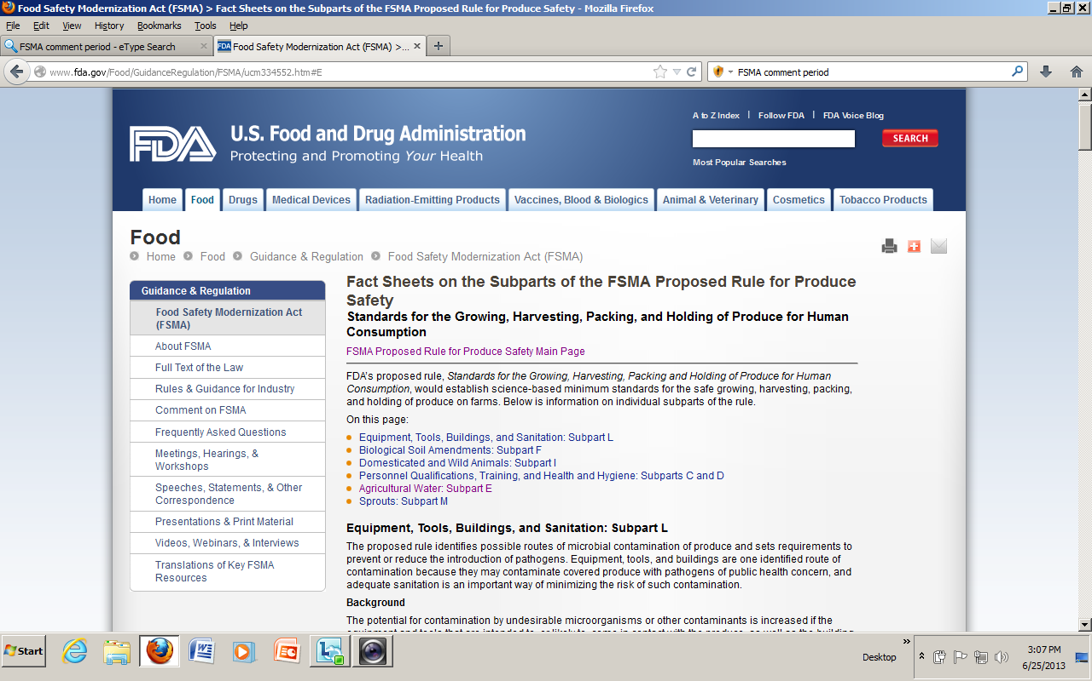

Slide 8
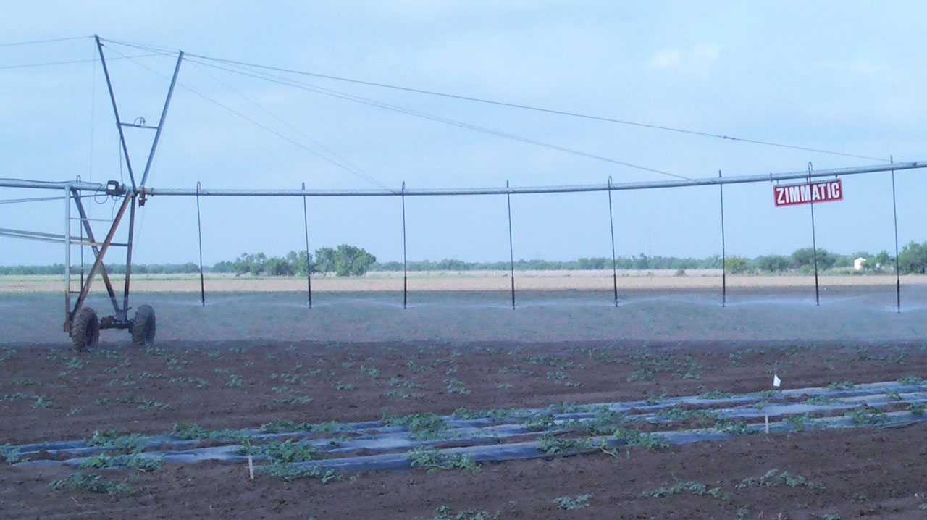
Water #1 Field Hazard
Anytime water comes in contact with fresh produce, its quality determines the potential for pathogen contamination since water may be a carrier of a number of types of microorganisms.
Water sources should be tested periodically for generic E. coli

Slide 9
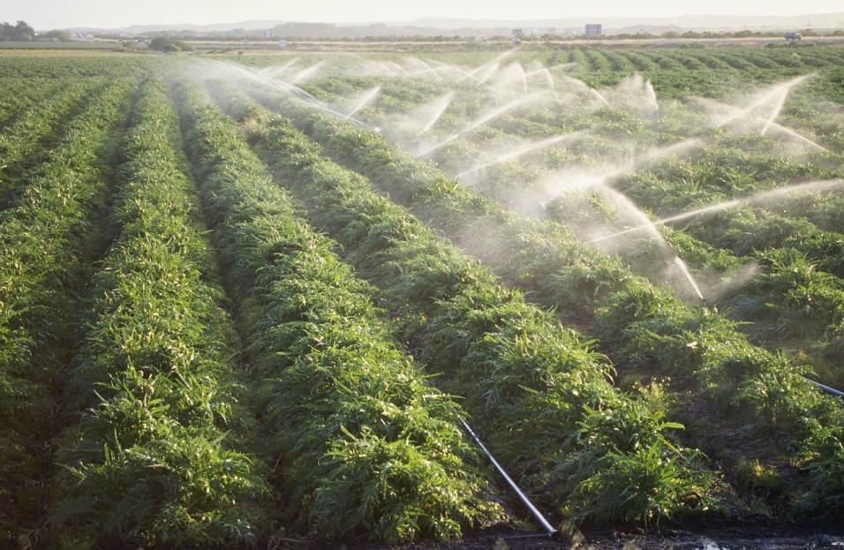
Preharvest
Irrigation source type:
Surface: greatest chance of contamination
Groundwater: less
Municipal: least
Methods:
Drip: least
Furrow: less
Overhead spray: greatest chance of contamination
Notes:
Water used for irrigation is a potential source of pathogens that can contaminate produce. The water quality depends on the source, which for the majority of American farmers comes from surface water sources. Because it is exposed to natural contamination and runoff from various land uses, surface water has the highest potential to contaminate produce through irrigation water. An agricultural producer can reduce risks of contamination by adopting best management practices on the land, such as installing an exclusion fence around a creek.
Groundwater is used for irrigation by 42% of American agricultural producers. The risks of contamination are lower because of the natural filtration of the soil and microbes. However, the well is a potential conduit to the groundwater from the surface and must by protected to prevent contamination. The steps of wellhead protection, as discussed earlier, will help to reduce those risks.
In some cases, municipal water is used for irrigation. The threat of contamination here is the lowest because the water was treated to drinking water standards by the local utility.
The method of irrigation can also determine the risk of contamination. Both furrow and drip irrigation have a low risk of contamination because water is applied either on the ground surface or below the surface where it won’t come into contact with the above-ground produce.
Overhead spray irrigation has a higher risk of contamination because the water can come into contact with the produce. Of course this risk will vary depending on the type of crop and its growth stage.
9

Slide 10
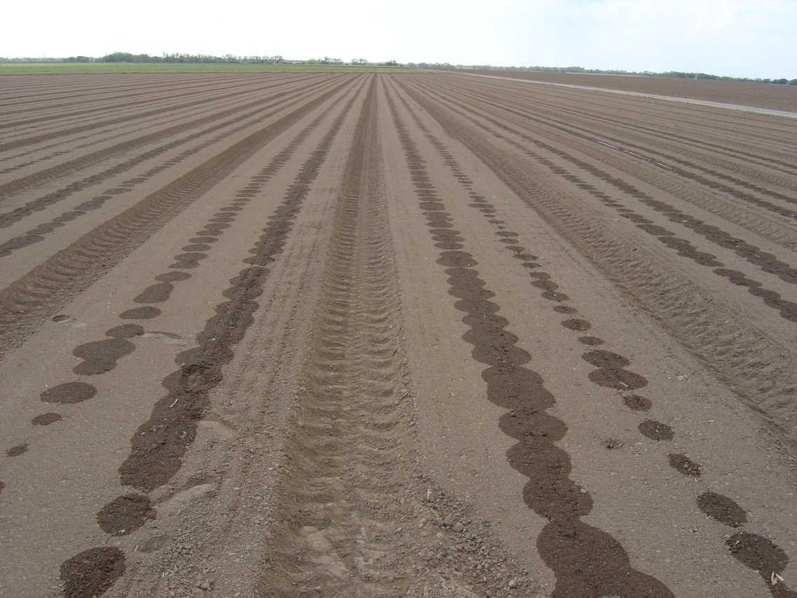
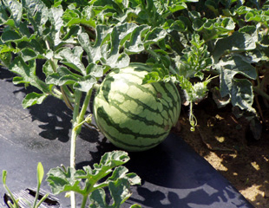
Irrigation Practices
Overhead irrigation is more likely to spread contamination, however a combination of drip and plastic results in the least spread of contamination.
Maintain records of safe irrigation practices
Notes:
Irrigation method can influence the spread of food borne pathogens.
Drip irrigation is by far the safest method.

Slide 11
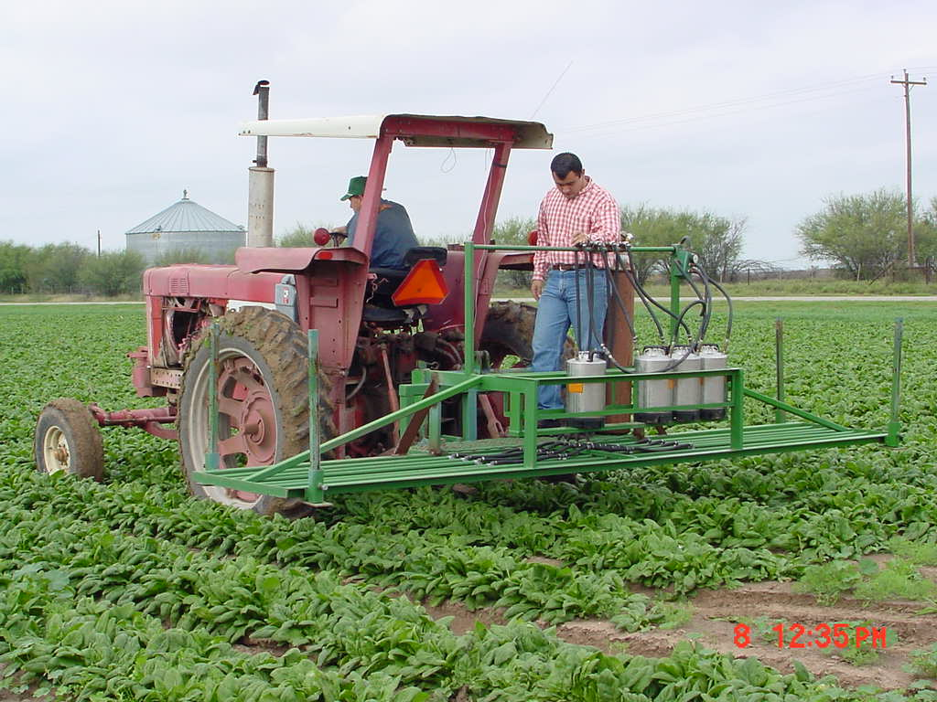
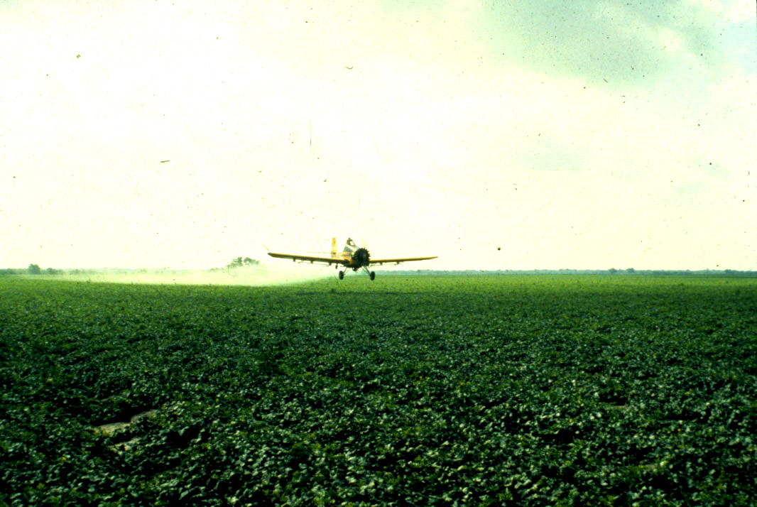
Other Water use:
– pest control
- frost protection
Always use potable water!
Notes:
Often overlooked is the potential for contaminating a crop with food borne pathogens is the spray water. Some growers believe because a pesticide is being sprayed that the bacteria will be killed. Not so. Bacteria specific products are the only kill compound. However, these may not be practical to use. Therefore, sanitation and the use of pathogen free water is the best option.

Slide 12
3 Major Areas Addressed by California GAPs Metrics
Water sampling – all sources with metrics established
Soil amendments – manure-based amendments and non-synthetic crop treatments certification
Animal encroachment and adjacent land metrics

Slide 13
Most Calif. GAPs Relate to Water
Preharvest foliar (contact) <126 E. coli per 100 mls
(rolling geometric mean of 5 numbers)
single sample <235 E. coli per 100 mls
Preharvest non-foliar (non-contact) <126 E. coli per 100 mls
(rolling geometric mean of 5 numbers)
single sample <575 E. coli per 100 mls
Post harvest (contact) < 2 E. coli per 100 mls single sample

Slide 14
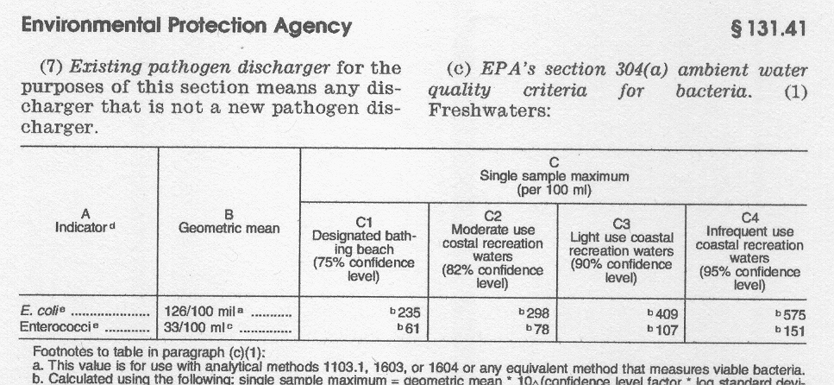

Slide 15
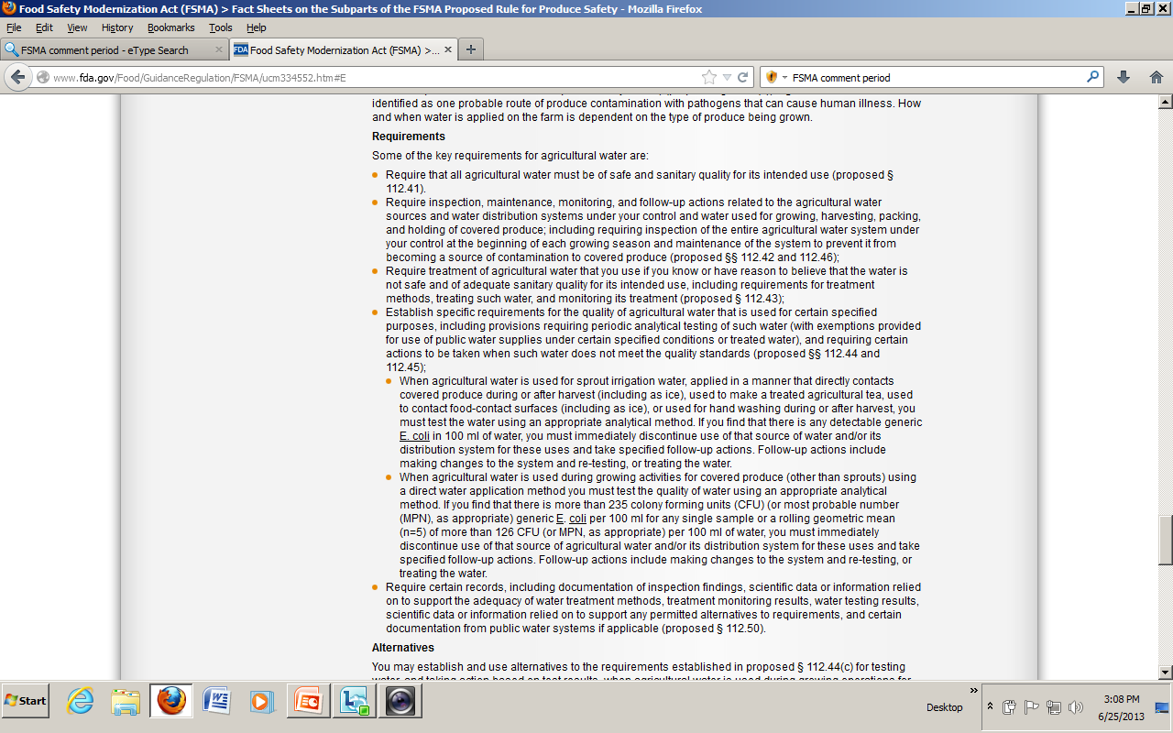

Slide 16
1442 ill, with 286 hospitalizations and possibly 2 deaths

Slide 17
Produce distributor
positive sample
from Farm A
Mexico Farm
positive sample
Mexico Farm B
positive irrigation
water sample

Slide 19
Outline of Farm Traceback
FDA reported isolation of the outbreak strain from a jalapeño pepper sample obtained from one of these distributors.
The pepper likely was grown on a farm in Tamaulipas, Mexico (farm A); this farm also grew serrano peppers and Roma tomatoes. FDA did not isolate the outbreak strain from environmental samples from farm A
Did isolate the outbreak strain from a sample of serrano peppers and a sample of water from a holding pond used for irrigation from another farm (farm B) in Tamaulipas. Farm B also grew jalapeño peppers, but not tomatoes.
Farms A and B provided produce to a common packing facility in Mexico that exports to the United States.

Slide 29
California/Arizona Water Database
Generic E. coli per 100 mls
91.6%
5.7% 2.0% 0.4% 0.3%
Total = 2553

Slide 30
QUESTIONS?
LINKS
http://www.fda.gov/Food/GuidanceRegulation/FSMA/ucm334552.htm#E
http://soiltesting.tamu.edu/webpages/publications.html

